Slide 1


Social Media Honour
Friend Class
Notes:
Brief prayer by volunteer before starting.

Slide 2
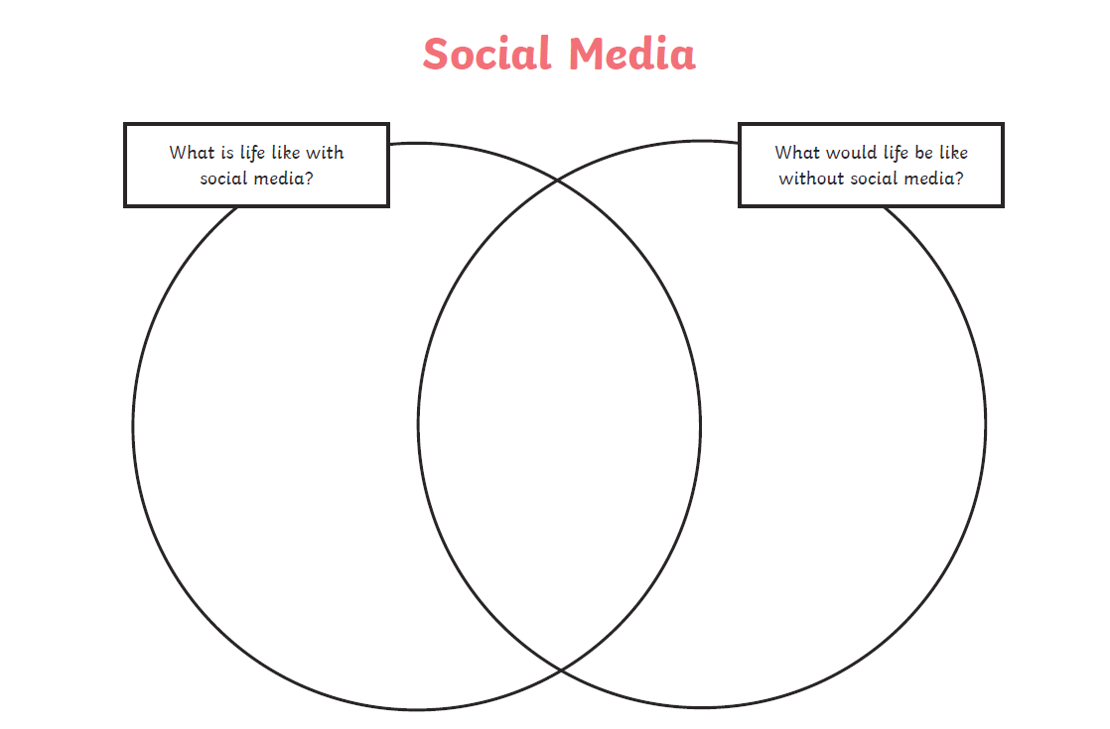

This honour is about thinking about the two questions above and applying the advice from the Holy Bible!
Notes:
What we want to achieve by the end of the session.

Slide 3

What is Social Media
Social media is the means by which communication among user groups is encouraged by creating, sharing, and exchanging information of interest.
This differs from traditional media (newspapers, television, magazines, radio, outdoor displays) in many ways but most significantly by who controls the message and content.
Social media is democratized with anyone with Internet access able to join, generate content, promote content, and discuss content.
Traditional media is controlled by a corporation and its staff who decide what messages are sent out and, if there is feedback (like letters to the editor or similar) what feedback is shared over the media.
Notes:
Discuss two key aspects highlighted.

Slide 4

Complete Q1 - workbook
What is social media? Choose one correct answer. (Circle/Tick neatly)
A.A huge network of computers all connected together.
B. A collection of webpages found on this.
C. A set of related web pages located under a single domain name, typically produced by a single person or organization.
D. Websites and applications that enable users to create and share content or to participate in social networking.
Notes:
Complete Q1 multiple choice. Correct answer is D.

Slide 5






Can you identify these common social media sites?
What sort of features do they have? What can you do on them?
Notes:
Instagram
Pinterest
Snapchat
Tumblr
Youtube
Whatsapp
Tiktok
Facebook
Blogger
Twitter
Facebook

Slide 6
Q2. Types of Social Media - complete type and example
Type of Social Media | Definition | Example
1. | A digital audio file made available on the internet for downloading to a computer or mobile device, typically available as a series, new installments of which can be received by subscribers automatically. The files can be stored and played back on demand.e.g. sermons, seminars, like a radio show.
2. | Designed to connect people together who share common interests through the Internet. Each person that is a part of the social network has a profile that list their interest, as well as information they choose to reveal about themselves.
3. | A web-based dialogue site that promotes discussions by short messages. It facilitates discussion through organized threaded conversations. These sites often retain posts for a long time, and may be searchable. PHPBB is a popular, free-to-use forum package. Many hobbies have large forums devoted to the topic.
Notes:
1.Podcast - Q Kidscast
2.Social network service - Facebook
3.Internet forum - Instagram, Tiktok,Snapchat

Slide 7
Q2 Types of Social Media - complete type and example
Type of Social Media | Definition | Example
4. | A site designed for discussion or information purposes that contain post messages. These sites allow comments to be left along with images, as well as the opportunity for users to build social relations with their readers.
5. | the process of tagging and sharing references to resources that may be found on the Internet. Users are able to share, edit, and annotate web documents. The main information is not saved, just a bookmarked link and perhaps some brief explanation text guiding others to another website with the information to reference.
6. | The process of sending short messages among two or more devices over a network. This form of media has now developed into sending pictures, video, and sound.
Notes:
4. Social blogs - Blogger, Pinterest
5. Social bookmarking - Instagram, Twitter, Whatsapp
6. Text messaging - Whatsapp, Twitter, Instagram, Facebook

Slide 8
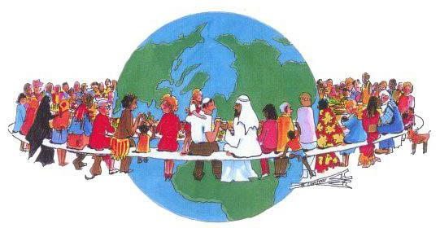


Q3 Advantages of Social Media - write context
Information can be spread very quickly over social media.
You can find things, people and resources very quickly on social media.
Social media can be used as a medium to learn from others, reading what people are thinking concerning topics of interest.
Notes:
Describe the picture - what context is the picture suggesting for the advantage
International family
Prayer requests
Journaling important events
Personal relationships
Evangelism

Slide 9

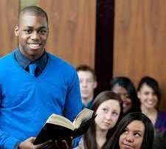
Q3 Advantages of Social Media - write context
Social media is fully capable of bringing people together from all backgrounds due to a common interest
Social media is an excellent tool that can be used for marketing and promotion.
Notes:
Describe the picture - what context is the picture suggesting for the advantage
Personal relationships
Evangelism

Slide 10
Q4. Disadvantages of Social Media - 3 in a Row
Write down any 3 numbers between 1 and 7 on your small table.
The teacher will have a topic associated with each number.
The teacher will call the number, and if you have written the number down AND can contribute a correct disadvantage/pitfall
Then you can cross out the number on your card.
Lets’ see who will get to 3 in a row first!
Notes:
List of topics on dangers/pitfalls: Use non sequential numbers and play a couple of times (2 or 3)
1.Bullying
2.Data collection by unknown third parties
3.Targeted marketing/advertising
4.Gaming
5.Addiction
6.Publicity of information once posted online
7.Posting information that may affect future employment.

Slide 11
Debate
Should the age restrictions on social media be more fiercely enforced and monitored or should the age restrictions be removed?
Notes:
Debate Question

Slide 12
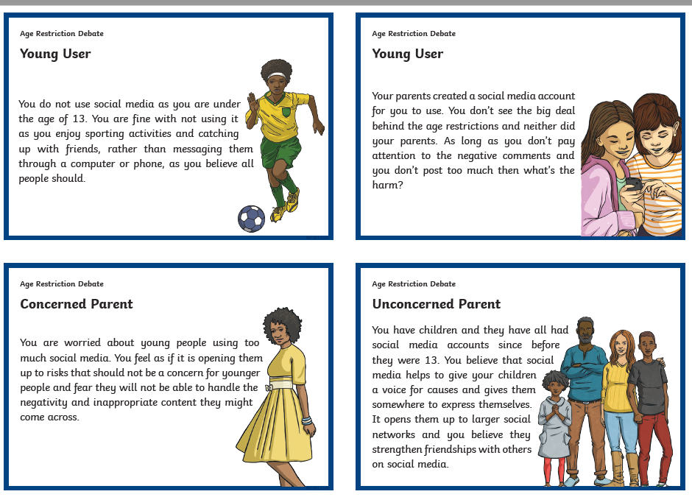
Q5 Choose one perspective and discuss with the class
Notes:
Set up a short debate. Split learners into the 4 perspectives on this issue.
Discuss

Slide 13
Q6. Social media and different learners
Think of the different ways that social media can be used to engage with different types of learners.Let’s briefly discuss your thoughts. Now come up with one clue for each of the words below.
Visual
Auditory
Read (or use the alternative write)
Kinesthetic
Create your own puzzle using this website/ or use paper and write one:
https://puzzlemaker.discoveryeducation.com/criss-cross
This is a website that helps you to make a puzzle from scratch. The link above is for a simple crossword.
Notes:
Brief discussion then learners can create their own puzzle via the website or on paper (those on paper may need to finish after the session)
If you split up the class and each comes up with the clue for 1, 2, 3 or 4 and add to chat this will speed up the process
Next learners can click on the link and add the keyword and clue accordingly.
Remind them to save their picture/print their picture/ paste their picture to include it with the rest of their work today.

Slide 14
Q7. Advice from the bible
Advice from the bible on how to communicate on social media sites. NKJV
Read each verse and fill in the gaps.
Matthew 24:14: I can use social media in a p ________________ manner by p_____________ the gospel in all the world as a w_______________ to all the nations.
Matthew 28:19: Social media can be used to make d____________________ of all the nations using c______________ such as images, videos and text that is appropriate to my c_________________ upbringing.
Notes:
Matthew 24:14 polite , preaching, witness
Matthew 28:19 disciples, content, christian

Slide 15
R7. Advice from the bible
Advice from the bible on how to communicate on social media sites. NKJV
Read each verse and fill in the gaps.
Ephesians 4:29: In my i__________________ with others on social media sites, I must not use c_______________ words but rather what is g_____________ for necessary e_____________ in order to impart g________________ to the hearers.
Proverbs 15:28: In my r_____________ to others when communicating on social media, I should s_______________ how to answer, so that my words are always kind.
Notes:
Ephesians 4:29 interaction, corrupt, good, edification, grace
Proverbs 15:28, replies (alt. Word responses), study

Slide 16
Q8 Advice from the bible
Read Philippians 2
Unity through humility
The humbled and exalted Christ
Light bearers
Notes:
One accord,like minded,no selfishness, esteem each other, interests of others
Humble oneself to God’s will. Think of the Law of Love, 10 commandments, Tell others the Good news of Jesus’ love
Obey in the absence of others seeing what you are doing,do not complain or dispute, be blameless, shine your light by promoting christianity implicitly and explicitly.

Slide 17
Q8 Look at some extracts from a social media profile
….Guess what I heard today? A person was arguing with another person!! …..I don't enjoy going to NAME of School and I only like Mrs Teacher name. …..Here is my address, street number and postcode, I would love to make new friends in my neighbourhood.. …..My parents are always working and leave me with my big sister overnight so I can chat after school. …...Just checked into a place with my sister, I am so bored as she is with her friends and I was forced to tag along.

Slide 18
Q8. Complete the reflection question...
Does the profile reflect the character of Jesus? Explain your answer
Suggest some improvements:

Slide 19
Q9. Spiritual based Social media use
This is important work for you to do after the curriculum camp to complete your honour!
Demonstrate your ability to use social media by creating a spiritually-based post for Children’s ministry or Pathfinders with your church media team/counsellors/ss teacher.
E.g design a post which can help people to not use social media until they are over the age limit.
E.g design a spiritually-based post on your favourite bible verse.
(A screenshot image/picture would be the best way to evidence this)

Slide 20
What we have learnt this session.
God bless and stay safe online.
Notes:
What we want to achieve by the end of the session.

