Slide 1
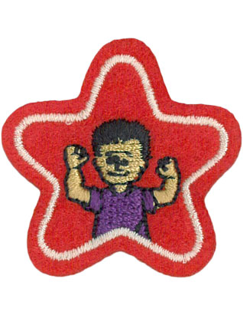
Healthy ME & Healthy Food Stars

Slide 2
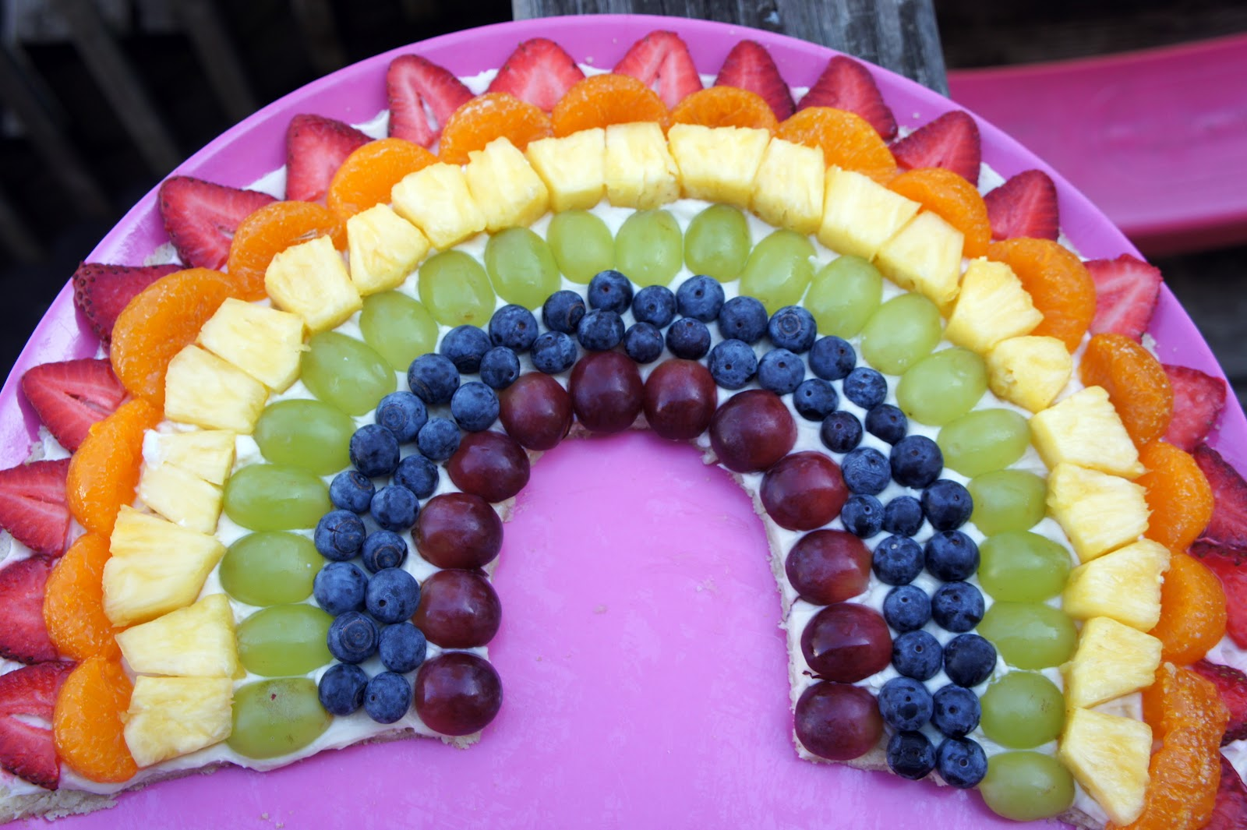
Game: fruit guessing
https://www.youtube.com/watch?v=kteZneJm1EI

Slide 3
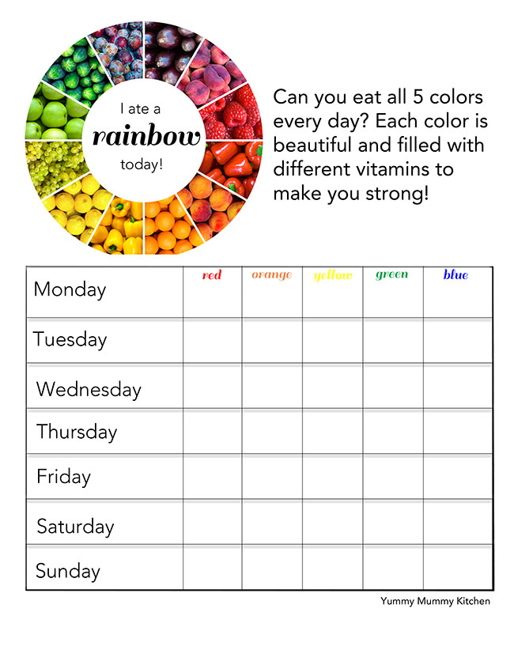
Healthy FooD star
1. Story title: Healthy eating
2. …. To work properly
3. Game: ‘fruit guessing’
4. Food Chart Eating a rainbow

Slide 4
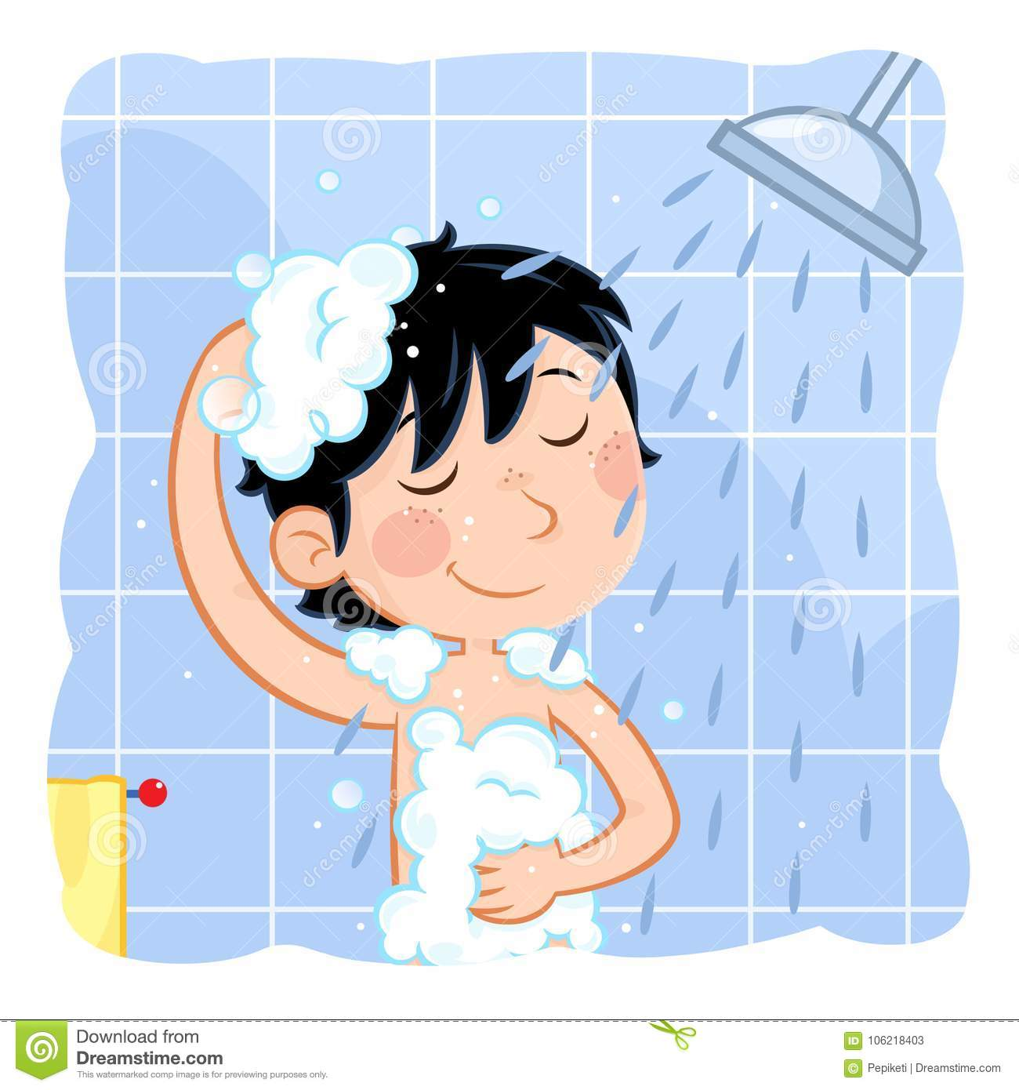
Healthy principles

Slide 5
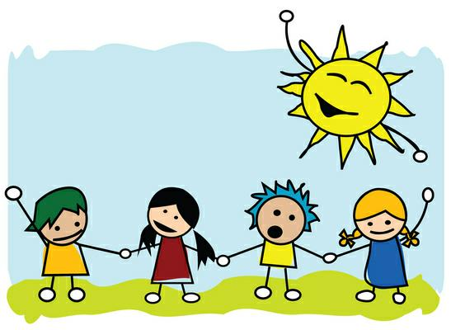

Slide 7
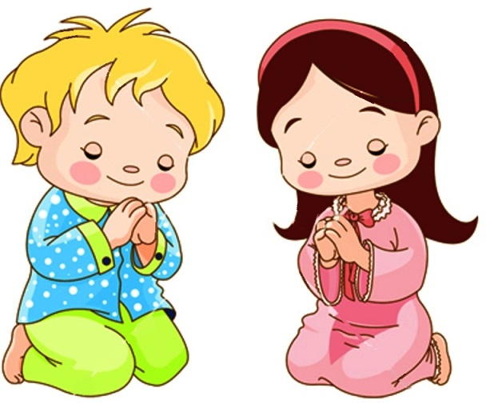

Slide 8
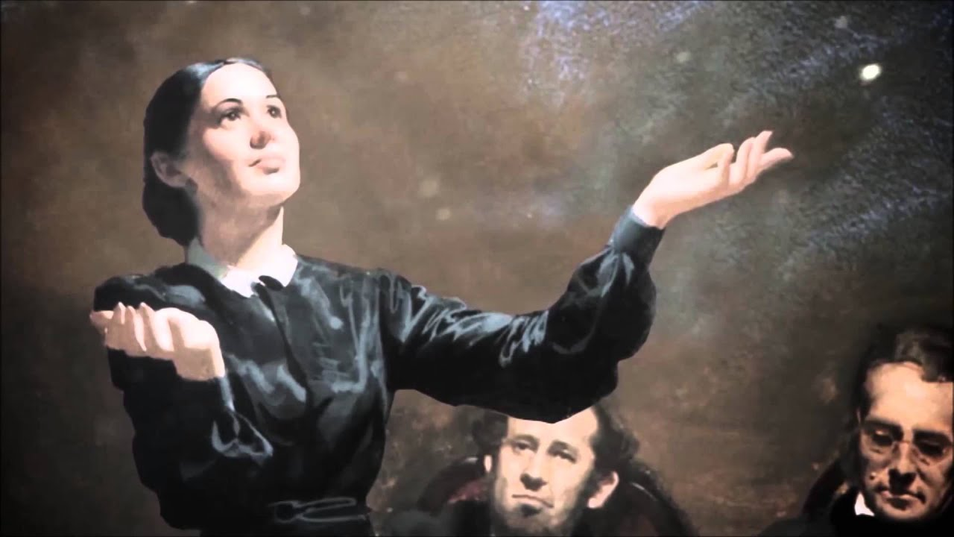
ELLEN WHITE God gave her visions about healthy living

Slide 9
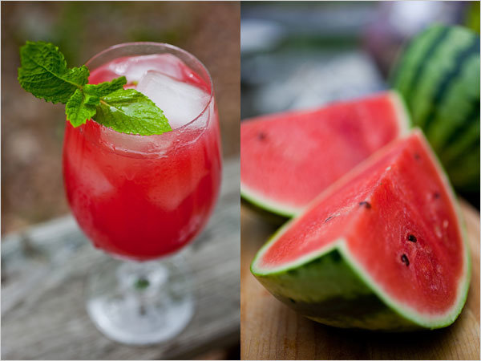
Vitamins and Minerals delicious help my body to work properly

Slide 10
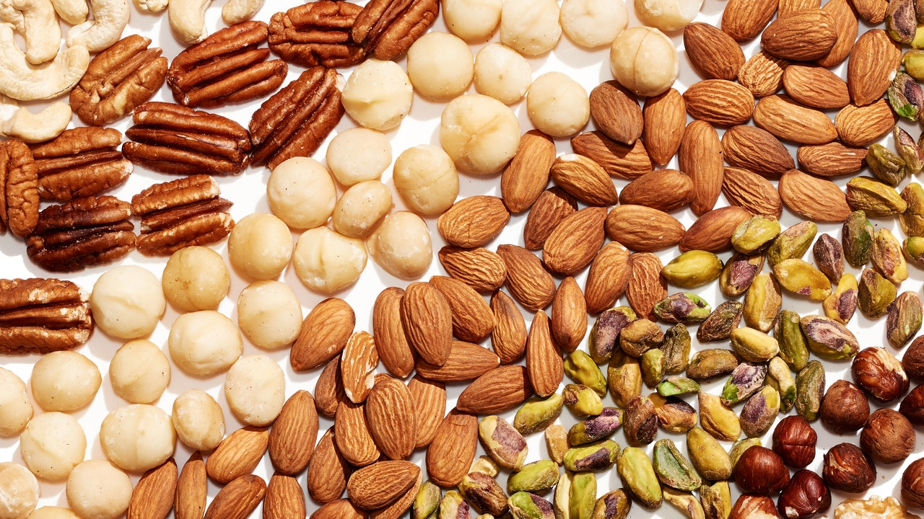

Slide 11
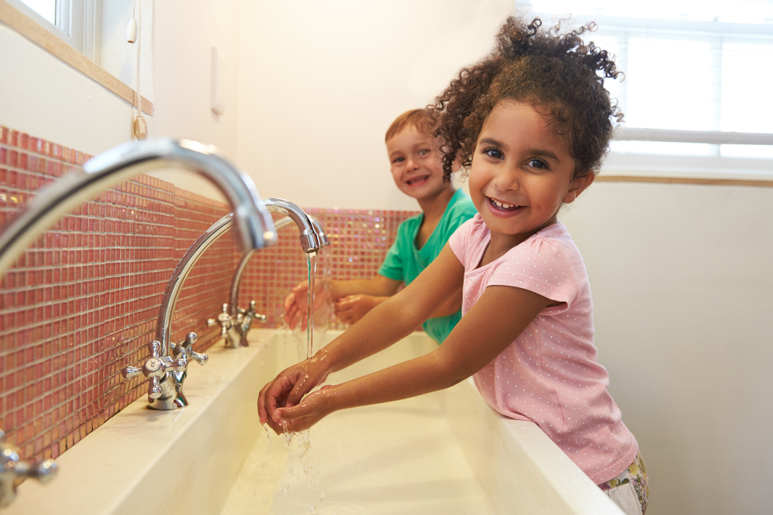
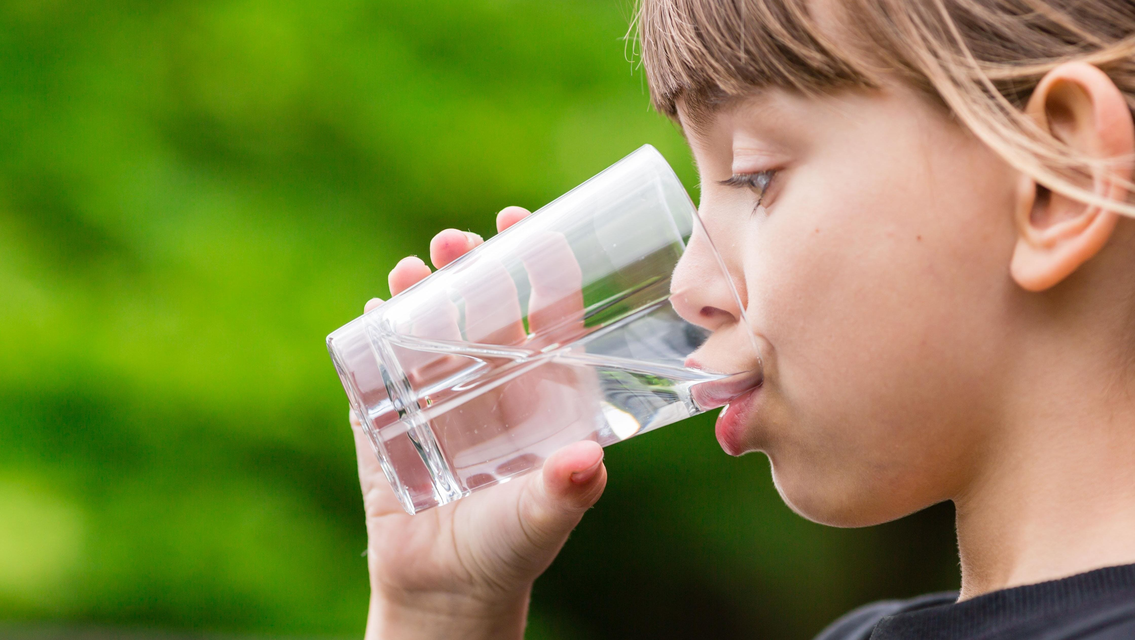
Water cleans me in and outside

Slide 12
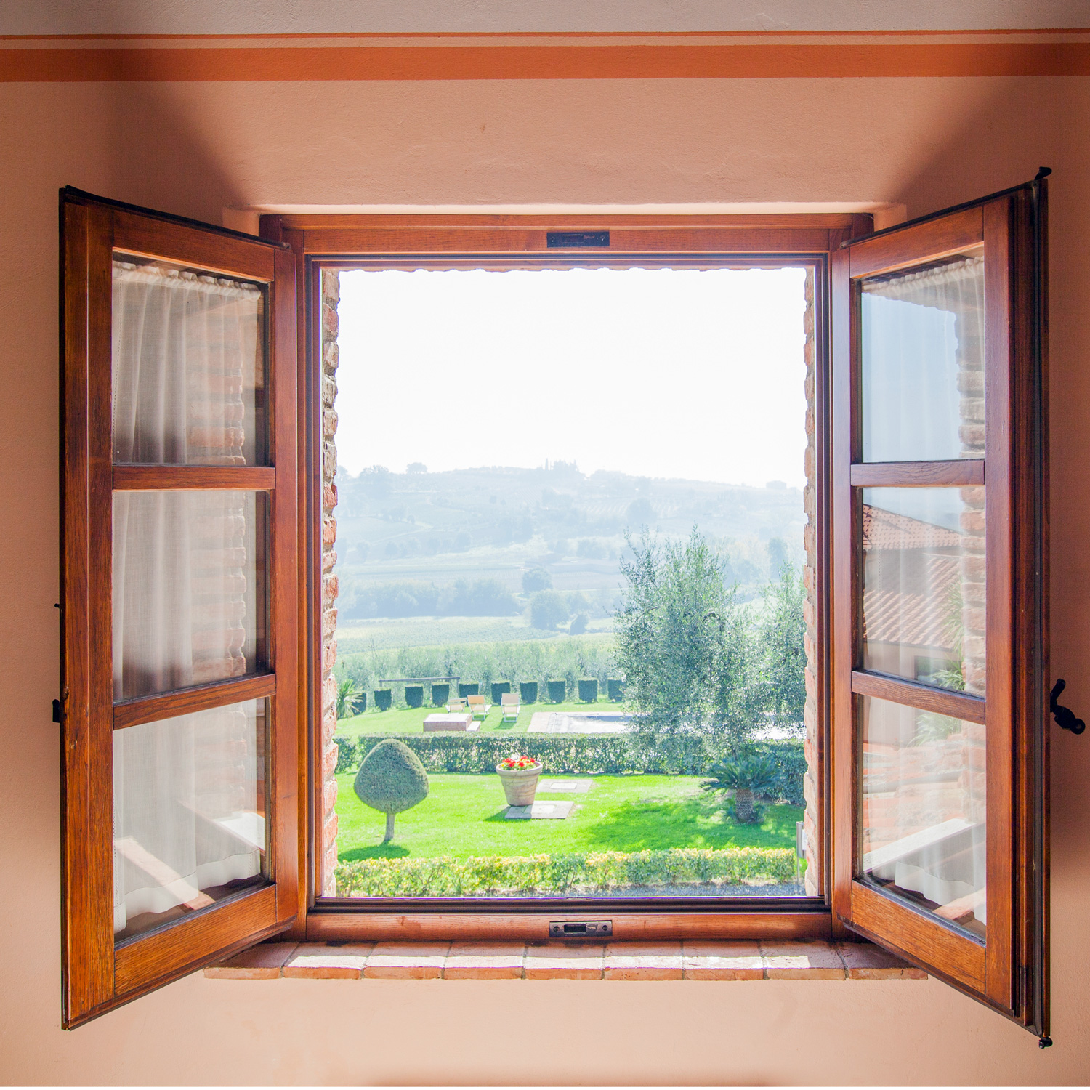
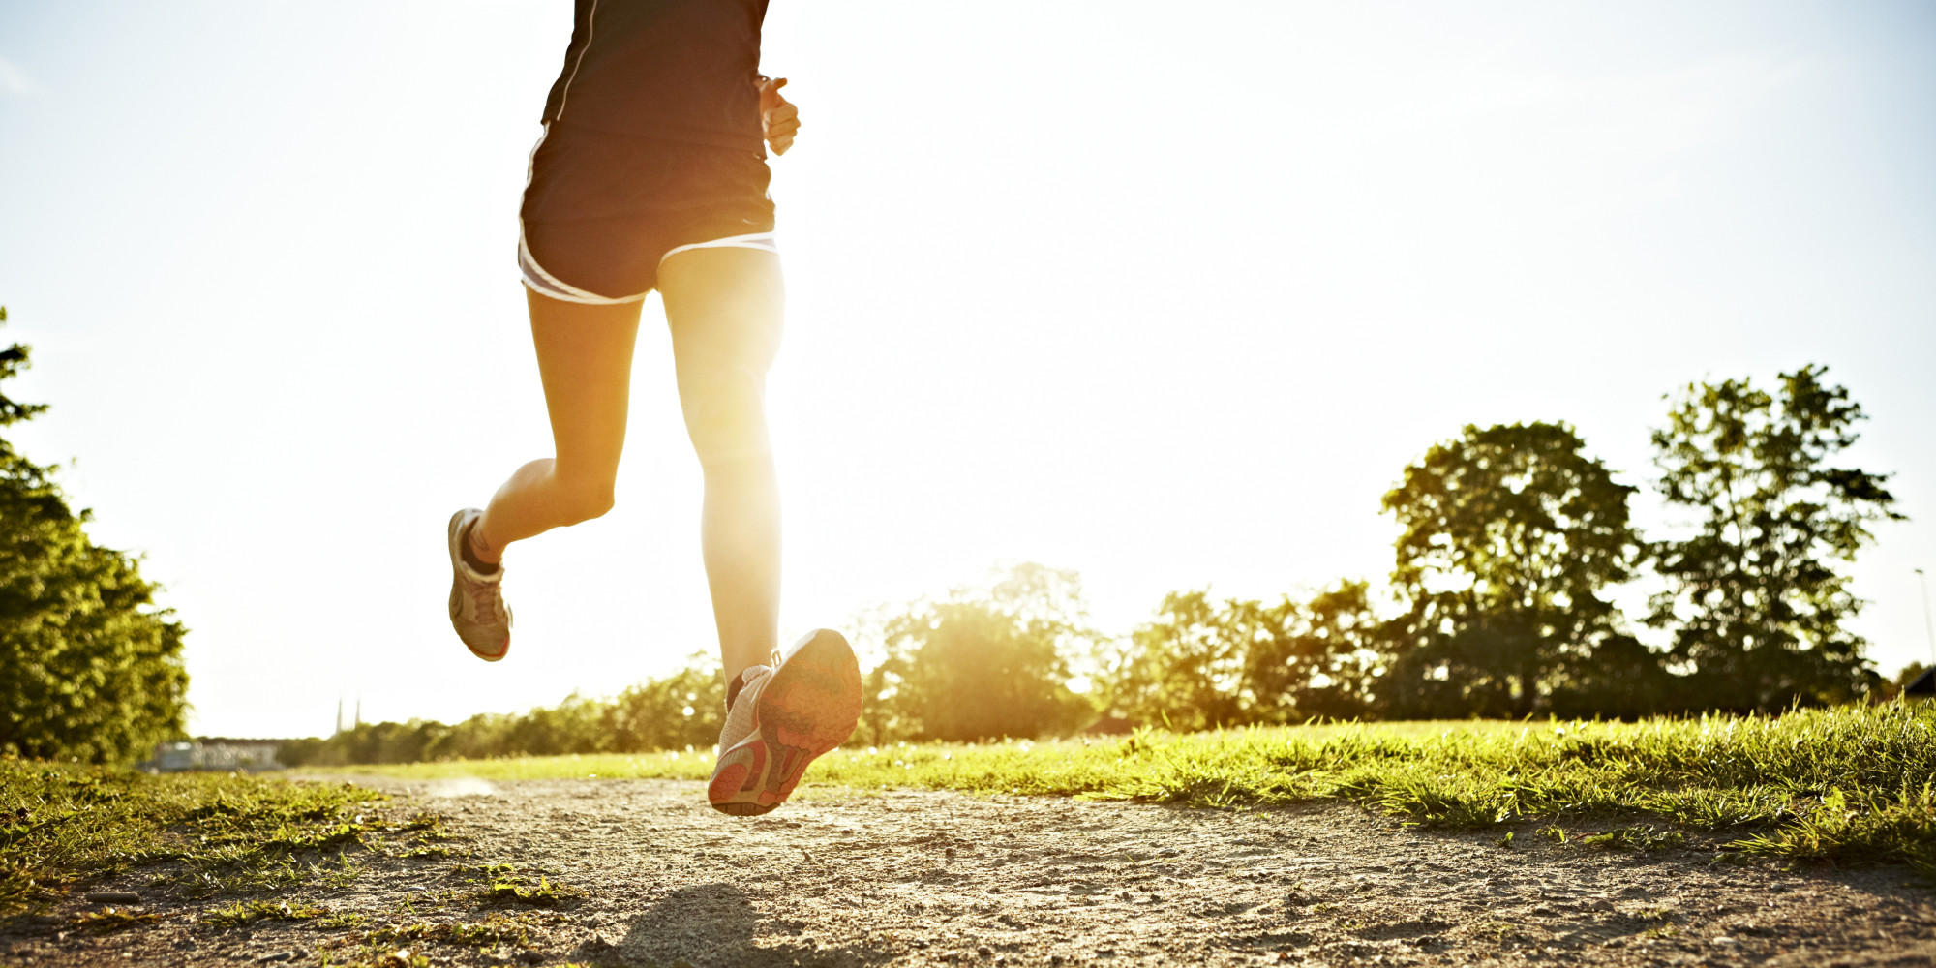

Slide 13
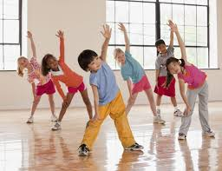
Exercises make my muscles stronger
https://www.youtube.com/watch?v=_j_m1S89_Ok

Slide 14
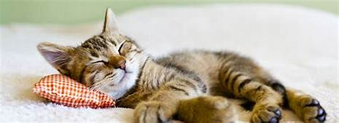
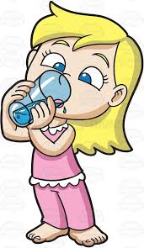
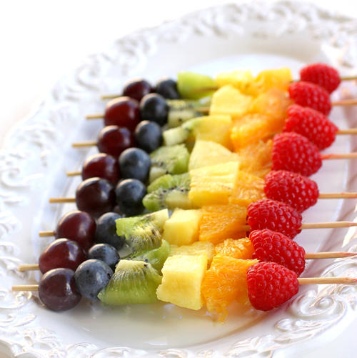

Slide 15
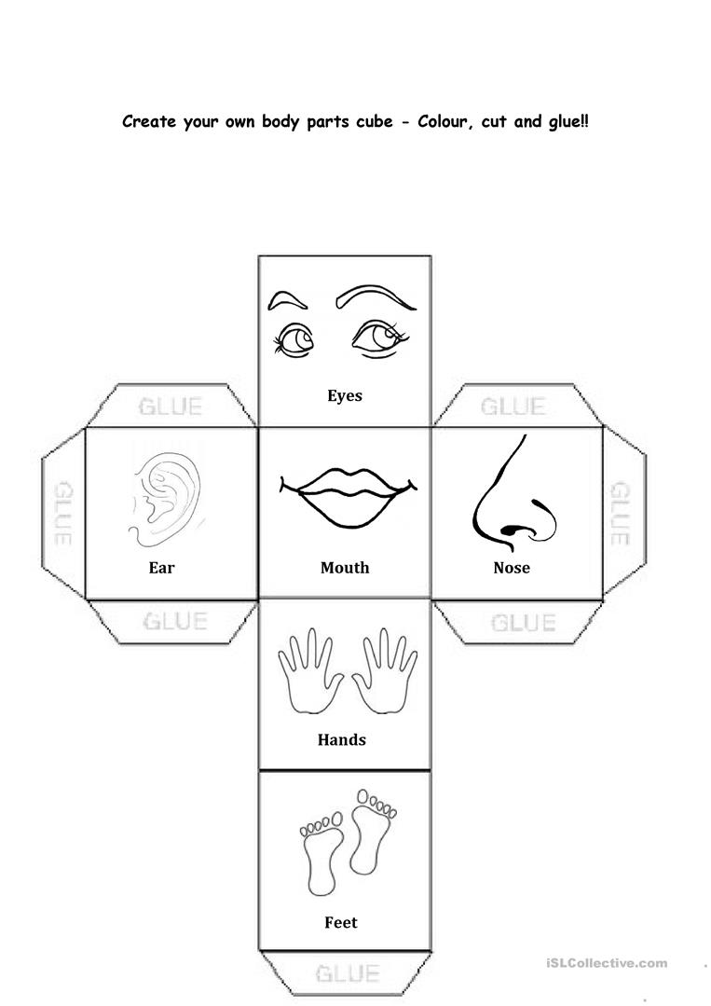
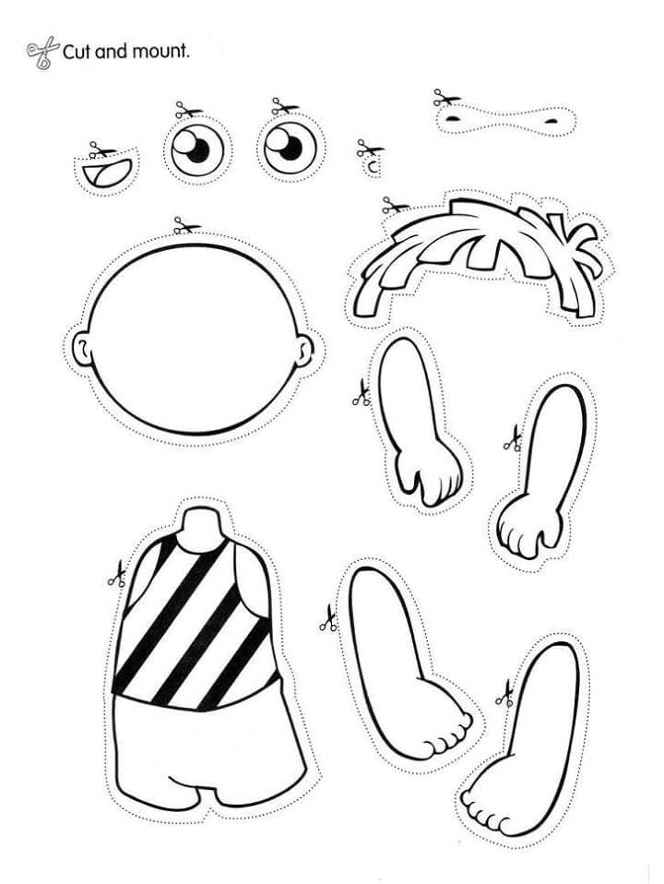
Healthy me star
Story: Healthy Principles
…stronger
3. body’s dice game
craft - glue the parts of the body
Song: Head, Shoulders, knees and toes

