Slide 1
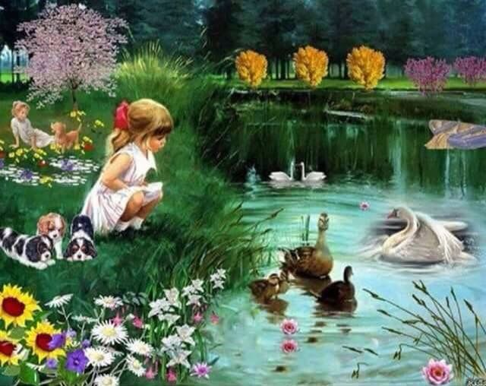

Slide 2
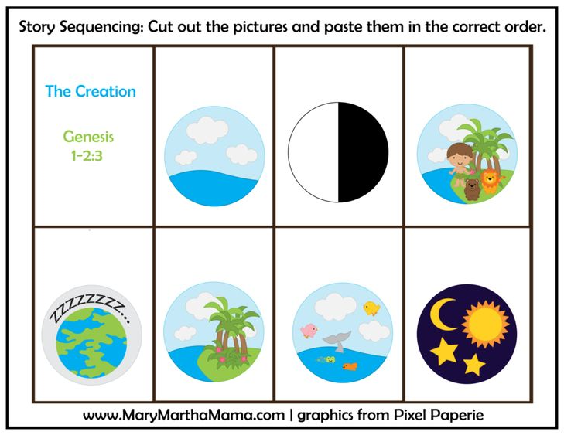
https://www.youtube.com/watch?v=i0LKuOwtbDc
https://www.youtube.com/watch?v=aoehyq6X650

Slide 3
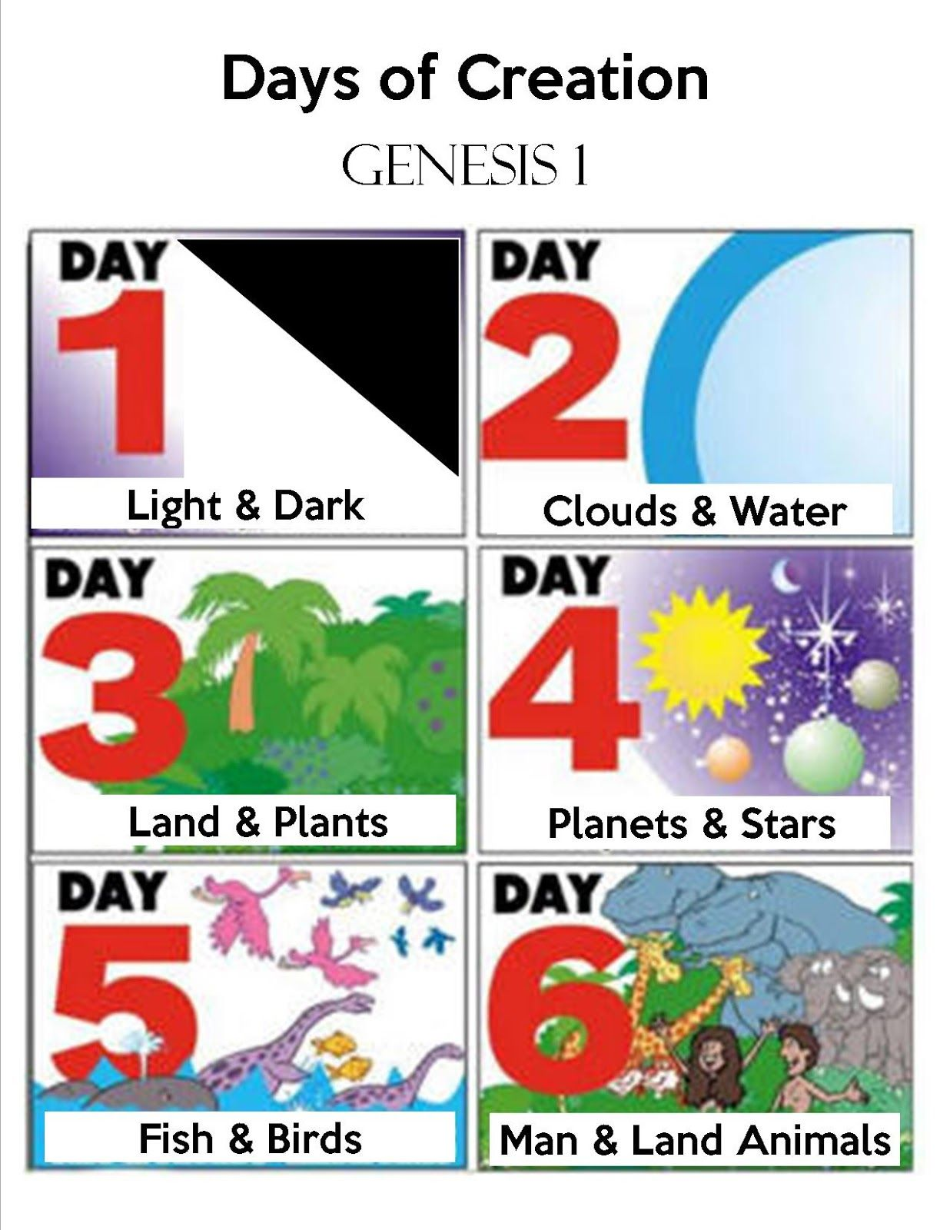
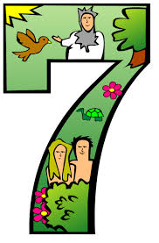

Slide 4
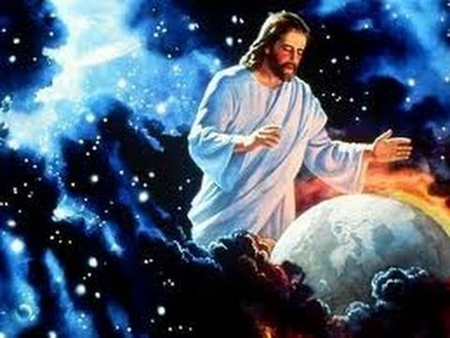
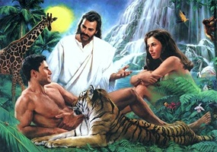
3 things I have learnt:
God made the world
God created man and woman
God blessed,
Rested day 7

Slide 5
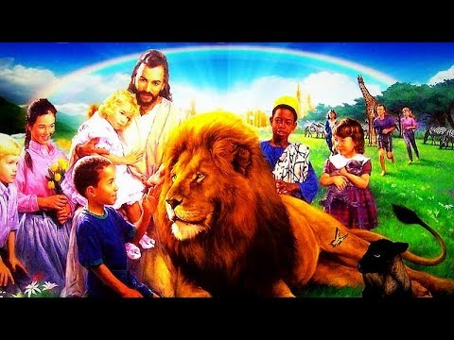
Memory gem

