Slide 1
Know your body
By
Sindi Mkwanazi

Slide 2
Learn I Corinthians 6:19.
Do you not know that your bodies are temples of the Holy Spirit, who is in you, whom you have received from God? You are not your own

Slide 3
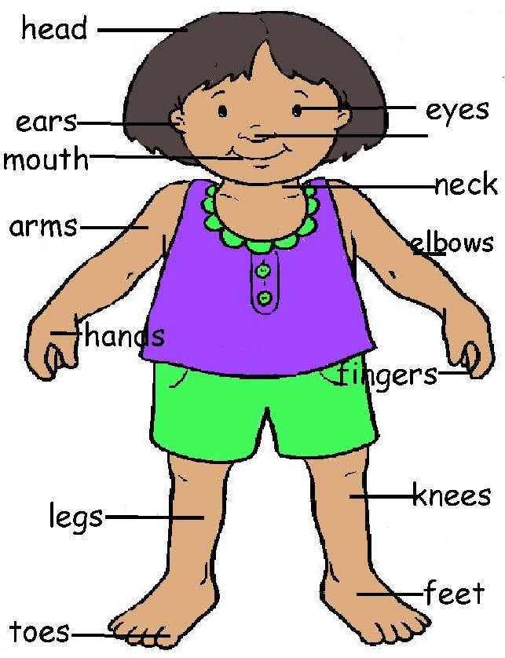
Twelve parts of your body
Head
Neck
Shoulder
Arm
Elbow
Hand
7. Fingers
8. Back
9. Legs
10. Knee
11. Feet
12. Toes

Slide 4
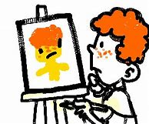
Now we are all going to draw ourselves and label the 12 parts of the body

Slide 5
What are knees for?
Knees support you body. They make It easy for you to walk, jump and run

Slide 6
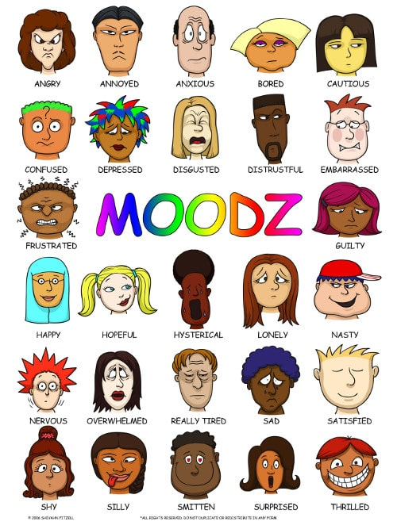
What does your face do for you & others?
What faces can you make with your face.
Does your face make other people happy?
Does your face make you smile when you look in the mirror?

Slide 7
Guess the facial expression

Slide 8
Guess the facial expression

Slide 9
Guess the facial expression

Slide 10
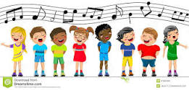
How can you use your mouth for Jesus?

Slide 11
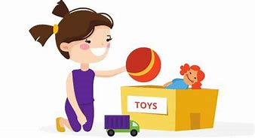
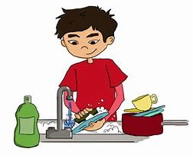
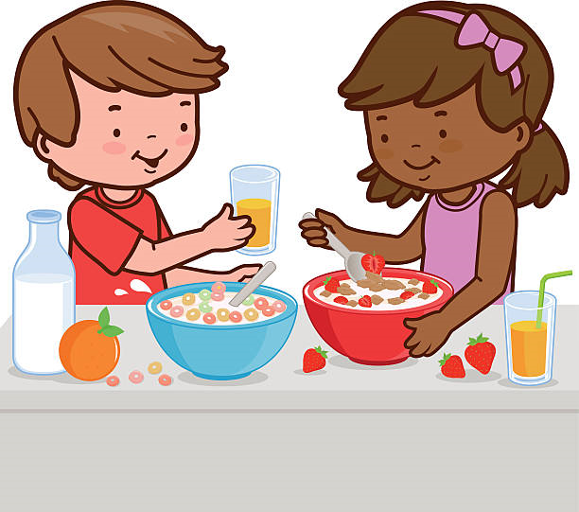
Using your hands

