Slide 1
PARABLES OF JESUS

Slide 2
https://www.youtube.com/watch?v=ygxm9AHxp8g

Slide 3
WHAT IS A PARABLE
A simple story to show something that is good
A simple story to show something that Jesus wants us to do

Slide 4
WHAT IS A PARABLE
The idea of PARABLEs is to make known mysteries of the Kingdom of heaven that have not been uncovered before.

Slide 5
WHAT IS A PARABLE
Jesus taught in the community in parables to make it difficult for other people to understand except by Jesus followers (Matt.13:13

Slide 6
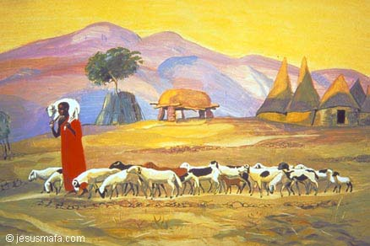
Parables from the 4 gospels
The lost sheep

Slide 7
PRODIGAL SON

Slide 8
The mustard seed

Slide 11
Wise & foolish servants

Slide 12
diaroma

Slide 13
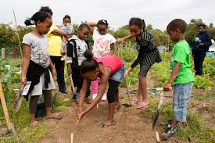
Physical game
Sowing of seeds

Slide 14
The good samaritan

Slide 15
GOOD SAMARITAN
MAKE A GET WELL CARD
MAKE A THINKING OF YOU CARD

Slide 16
GOOD SAMARITAN

Slide 17
GOOD SAMARITAN

