Slide 1


Adventurer Club Award – Baking

Slide 2

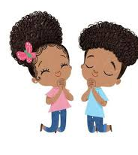

Slide 3
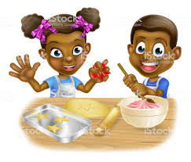
Goals and Objectives
What baking means?
2. Learn how to be safe in the kitchen.
3. Learn what some common baking terms mean.
4. Learn the names of some utensils used in baking projects.
5. What does the bible say about baking.
6. Bake 2 items of your choosing.

Slide 4

What is baking?

Slide 5
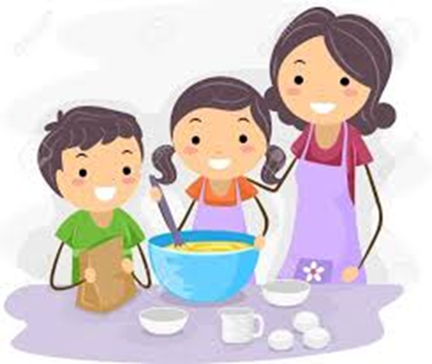
Baking is process of cooking by dry heat, especially in some kind of oven. It is probably the oldest cooking method. Bakery products, which include bread, rolls, cookies, pies, pastries, and muffins, are usually prepared from flour or meal derived from some form of grain.

Slide 6
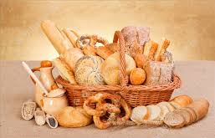
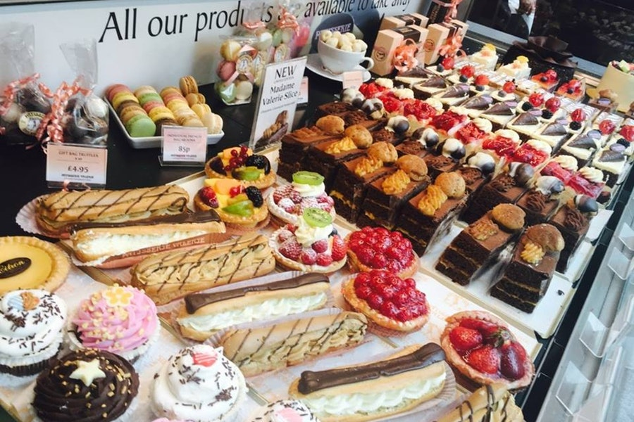
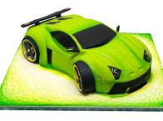
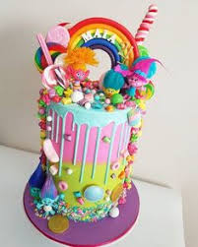

Slide 7
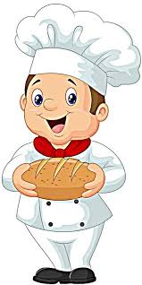
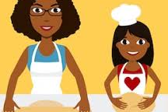
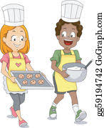


Slide 8


Slide 9
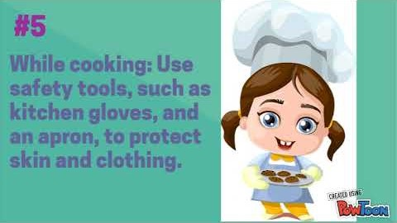

Slide 10
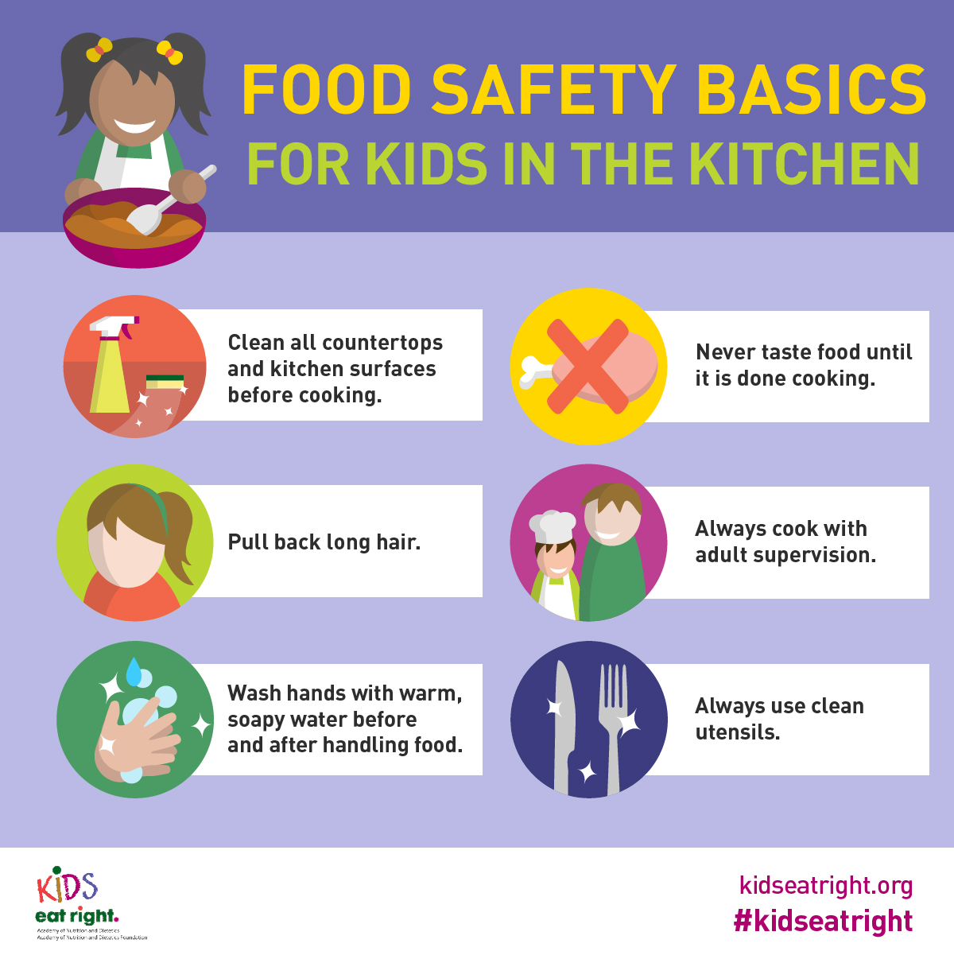

Slide 11
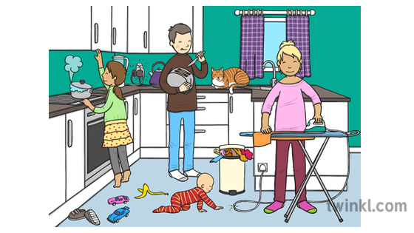
How many dangers can you spot ?

Slide 13
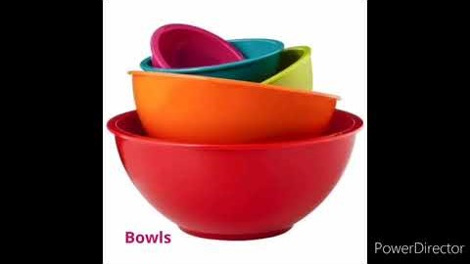

Slide 14
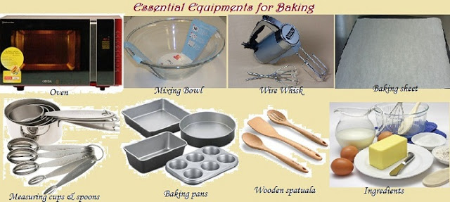
This Photo by Unknown Author is licensed under CC BY-NC-ND

Slide 15
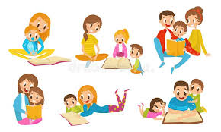
Activity:
Read 4 stories in the Bible where baking was mentioned.
Ask your parents to help

Slide 16
Who does Jesus say He is in John 6:35? Why is this important to us?

Slide 17

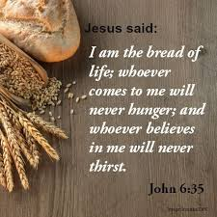

Slide 18


Slide 19
Activity:
Bake two items of your choice

Slide 20
