Slide 1
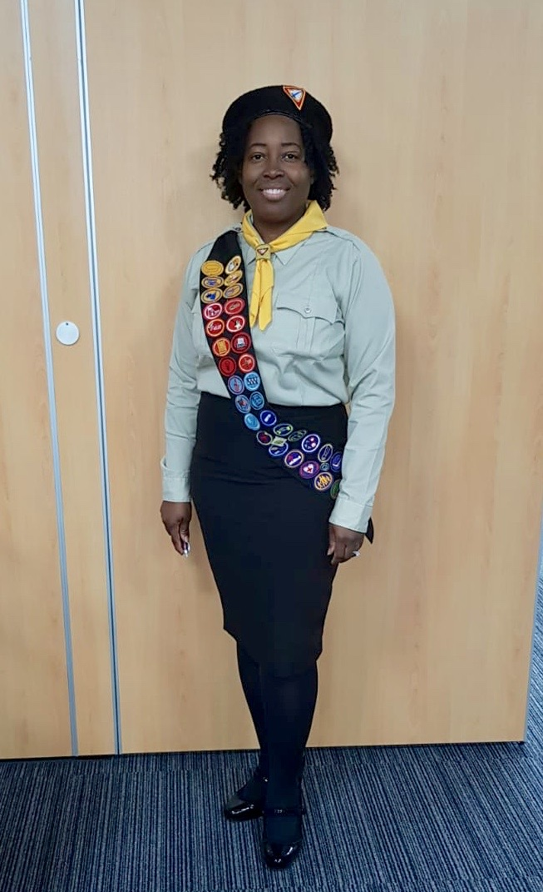
Hello HELPING HAND ADVENTURERS!
I am Your Instructor: DALE BYNG

Slide 2

TABERNACLE AWARD

Slide 3
WHAT IS A TABERNACLE?

Slide 4
The Tabernacle is Christ.
A Dwelling place.
A Holy place.
A place of Worship.

Slide 5
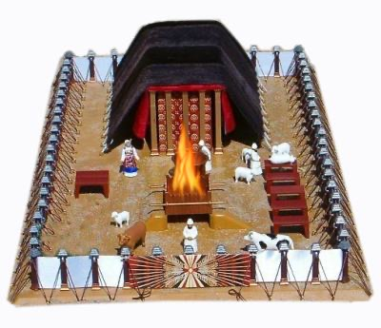

Slide 6
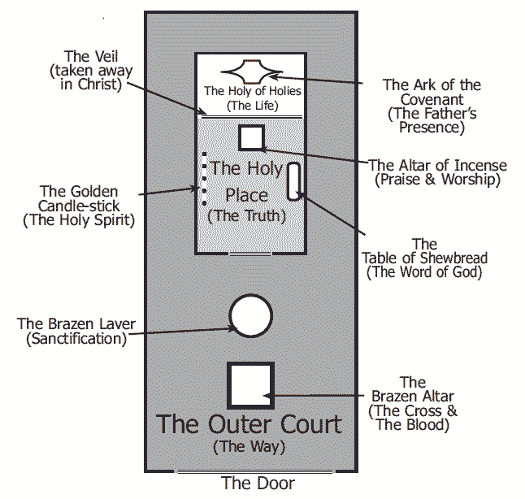
PARTS OF A TABERNACLE

Slide 7
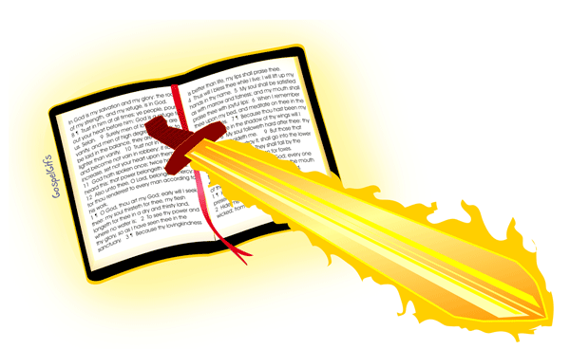
BIBLE DRAW SWORDS

Slide 8
1Corinthians 6:19 -
19What? know ye not that your body is the temple of the Holy Ghost which is in you, which ye have of God, and ye are not your own?

Slide 9
Exodus 25:8
8And let them make me a sanctuary; that I may dwell among them.

Slide 10
Exodus 29:44-46
    44And I will sanctify the tabernacle of the congregation, and the altar: I will sanctify also both Aaron and his sons, to minister to me in the priest's office.45And I will dwell among the children of Israel, and will be their God.46And they shall know that I am the LORD their God, that brought them forth out of the land of Egypt, that I may dwell among them: I am the LORD their God.

Slide 11


Slide 12
Hebrews 25:8 God Dwelt With Us: God commanded Moses for Israel, “Let them make Me a sanctuary; that I may dwell among them” (Exodus 25:8), and He abode in the sanctuary, in the midst of His people. Through all their weary wandering in the desert, the symbol of His presence was with them. So Christ set up His tabernacle in the midst of our human encampment. He pitched His tent by the side of the tents of men, that He might dwell among us, and make us familiar with His divine character and life. (Desire of Ages 23)

Slide 13

MEMORY ART — DRAW AND NAME THE 3 MAIN PARTS OF THE TABERNACLE

Slide 15
DISCUSSION
John 14:6 – Jesus saith unto him, I am the way, the truth, and the life: no man cometh unto the Father, but by me.
John 10:9 - I am the door: by me if any man enter in, he shall be saved, and shall go in and out, and find pasture.
Matthew 7:13-14 - Enter ye in at the strait gate: for wide is the gate, and broad is the way, that leadeth to destruction, and many there be which go in thereat:14because strait is the gate, and narrow is the way, which leadeth unto life, and few there be that find it.

Slide 16

SING ALONG

Slide 17






O be careful little eyes what you see O be careful little eyes what you see for the Father up above is looking down in love, so be careful little eyes what you see
O be careful little ears what you hear O be careful little ears what you hear for the Father up above is looking down in love, so be careful little ears what you hear
O be careful little tongue what you say O be careful little tongue what you say for the Father up above is looking down in love, so be careful little tongue what you say
O be careful little hands what you doO be careful little hands what you doFor the Father up aboveIs looking down in loveSo, be careful little hands what you do
O be careful little feet where you go O be careful little feet where you go for the Father up above is looking down in love, so be careful little feet where you go
O be careful little heart whom you trust O be careful little heart whom you trust for the Father up aboveIs looking down in love, so be careful little heart whom you trust
O be careful little mind what you think O be careful little mind what you think for the Father up above is looking down in love, so be careful little mind what you think, so be careful little mind what you think

Slide 18



Lord, prepare me to be a sanctuary
Pure and holy, tried and true
With thanksgiving,
I'll be a living
Sanctuary for You

Slide 19

QUIZzzzzz

Slide 20
WHAT’S INSIDE THE TABERNACLE?

Slide 21
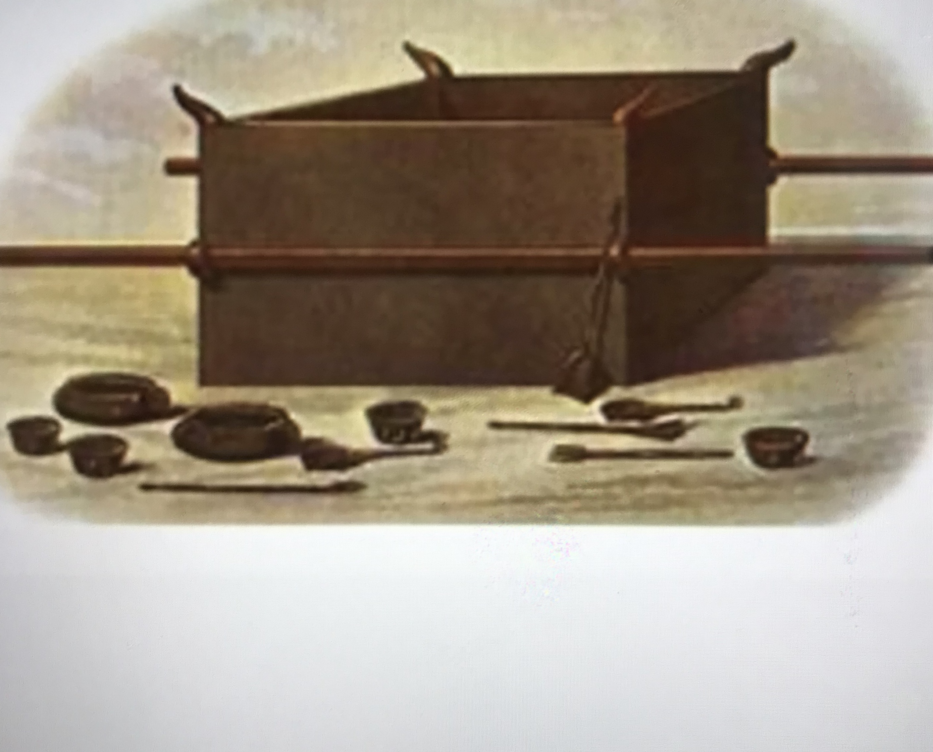
Bronze Altar
The bronze altar was the place of sacrifice. Bronze speaks of sin and the perpetual fire (Lev. 1:5-7) on the altar symbolizes God’s judgment against sin. Jesus died on an altar; it was called the cross. He died for our sins on that cross.

Slide 22
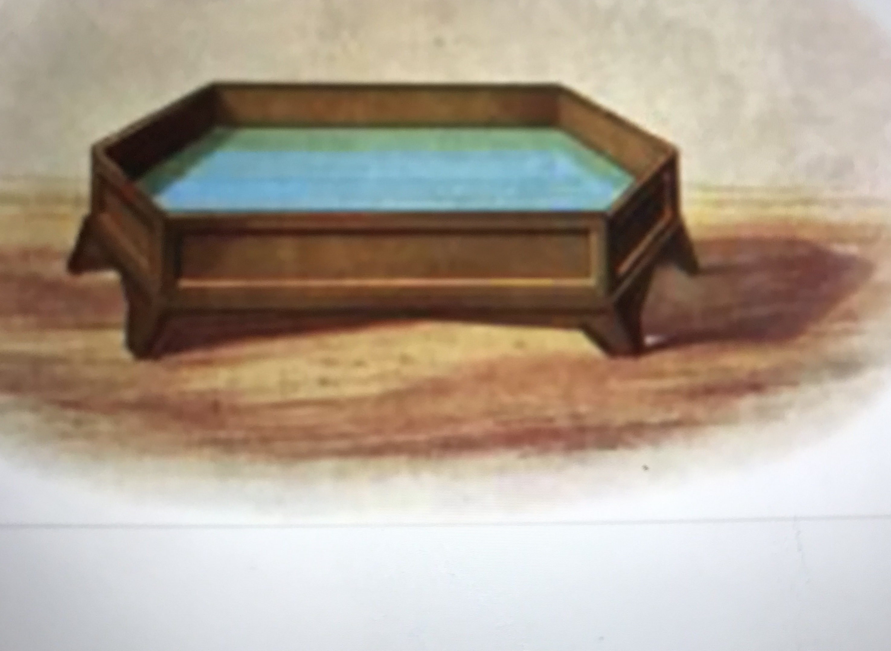
Bronze Laver
The bronze laver was filled with water, and its base was made from the women’s mirrors of highly polished bronze (Ex. 38:8). This is a great picture of a person who trusts Jesus for the forgiveness of sins. The laver symbolizes our cleansing from sin – our holiness. Once we are forgiven of our sins, God starts changing us to make us truly holy as He is holy (Phil. 2:12-13; 1 Pet. 1:16)

Slide 23
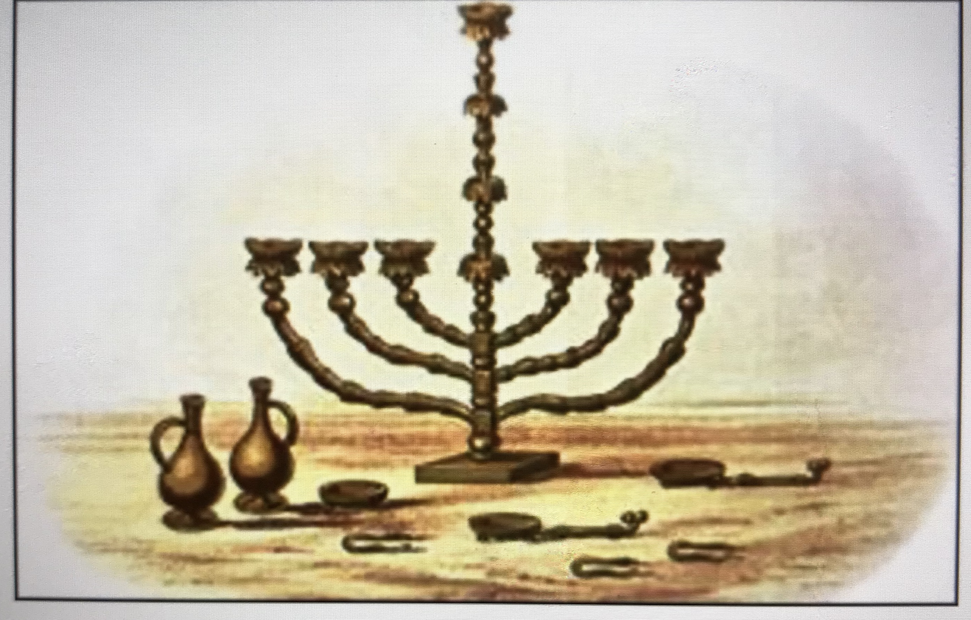
Golden Lampstand / Menorah
The lampstand, table of showbread and altar of incense are all made of gold. While bronze symbolizes sin, gold speaks of deity. The Holy Place is alive with symbolism about Jesus. The menorah speaks of the One who revealed the Father to us – Jesus the light giver (Matt. 11:27). He is the light of men.

Slide 24
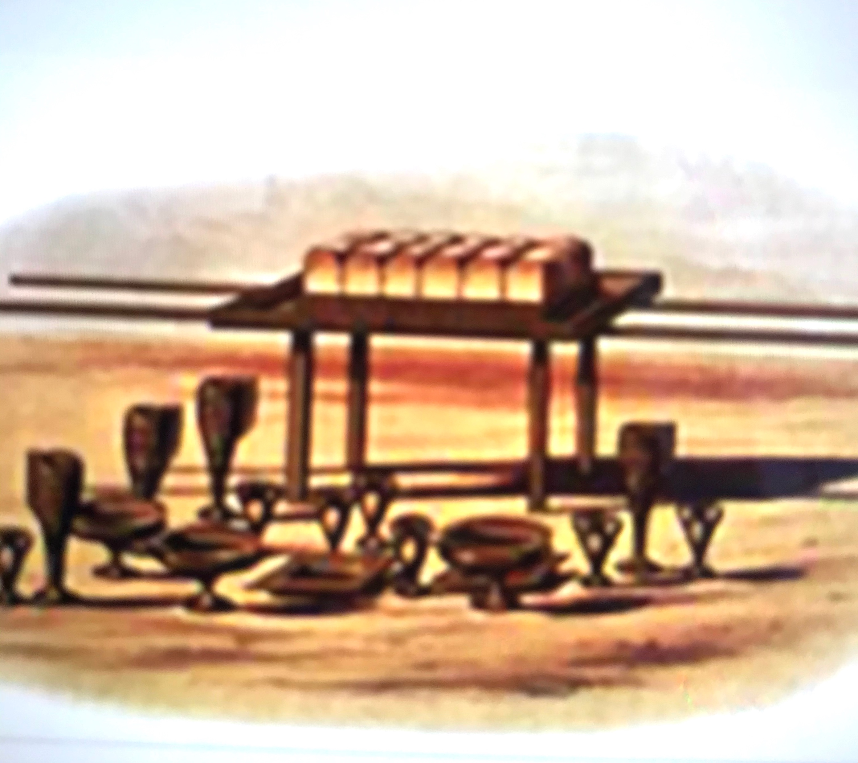
Table of Showbread
The table of showbread was made of acacia wood and overlaid with gold. The wood speaks of Jesus’ humanity and the gold of His deity. The bread that was placed on the table represents God’s presence in our lives.

Slide 25
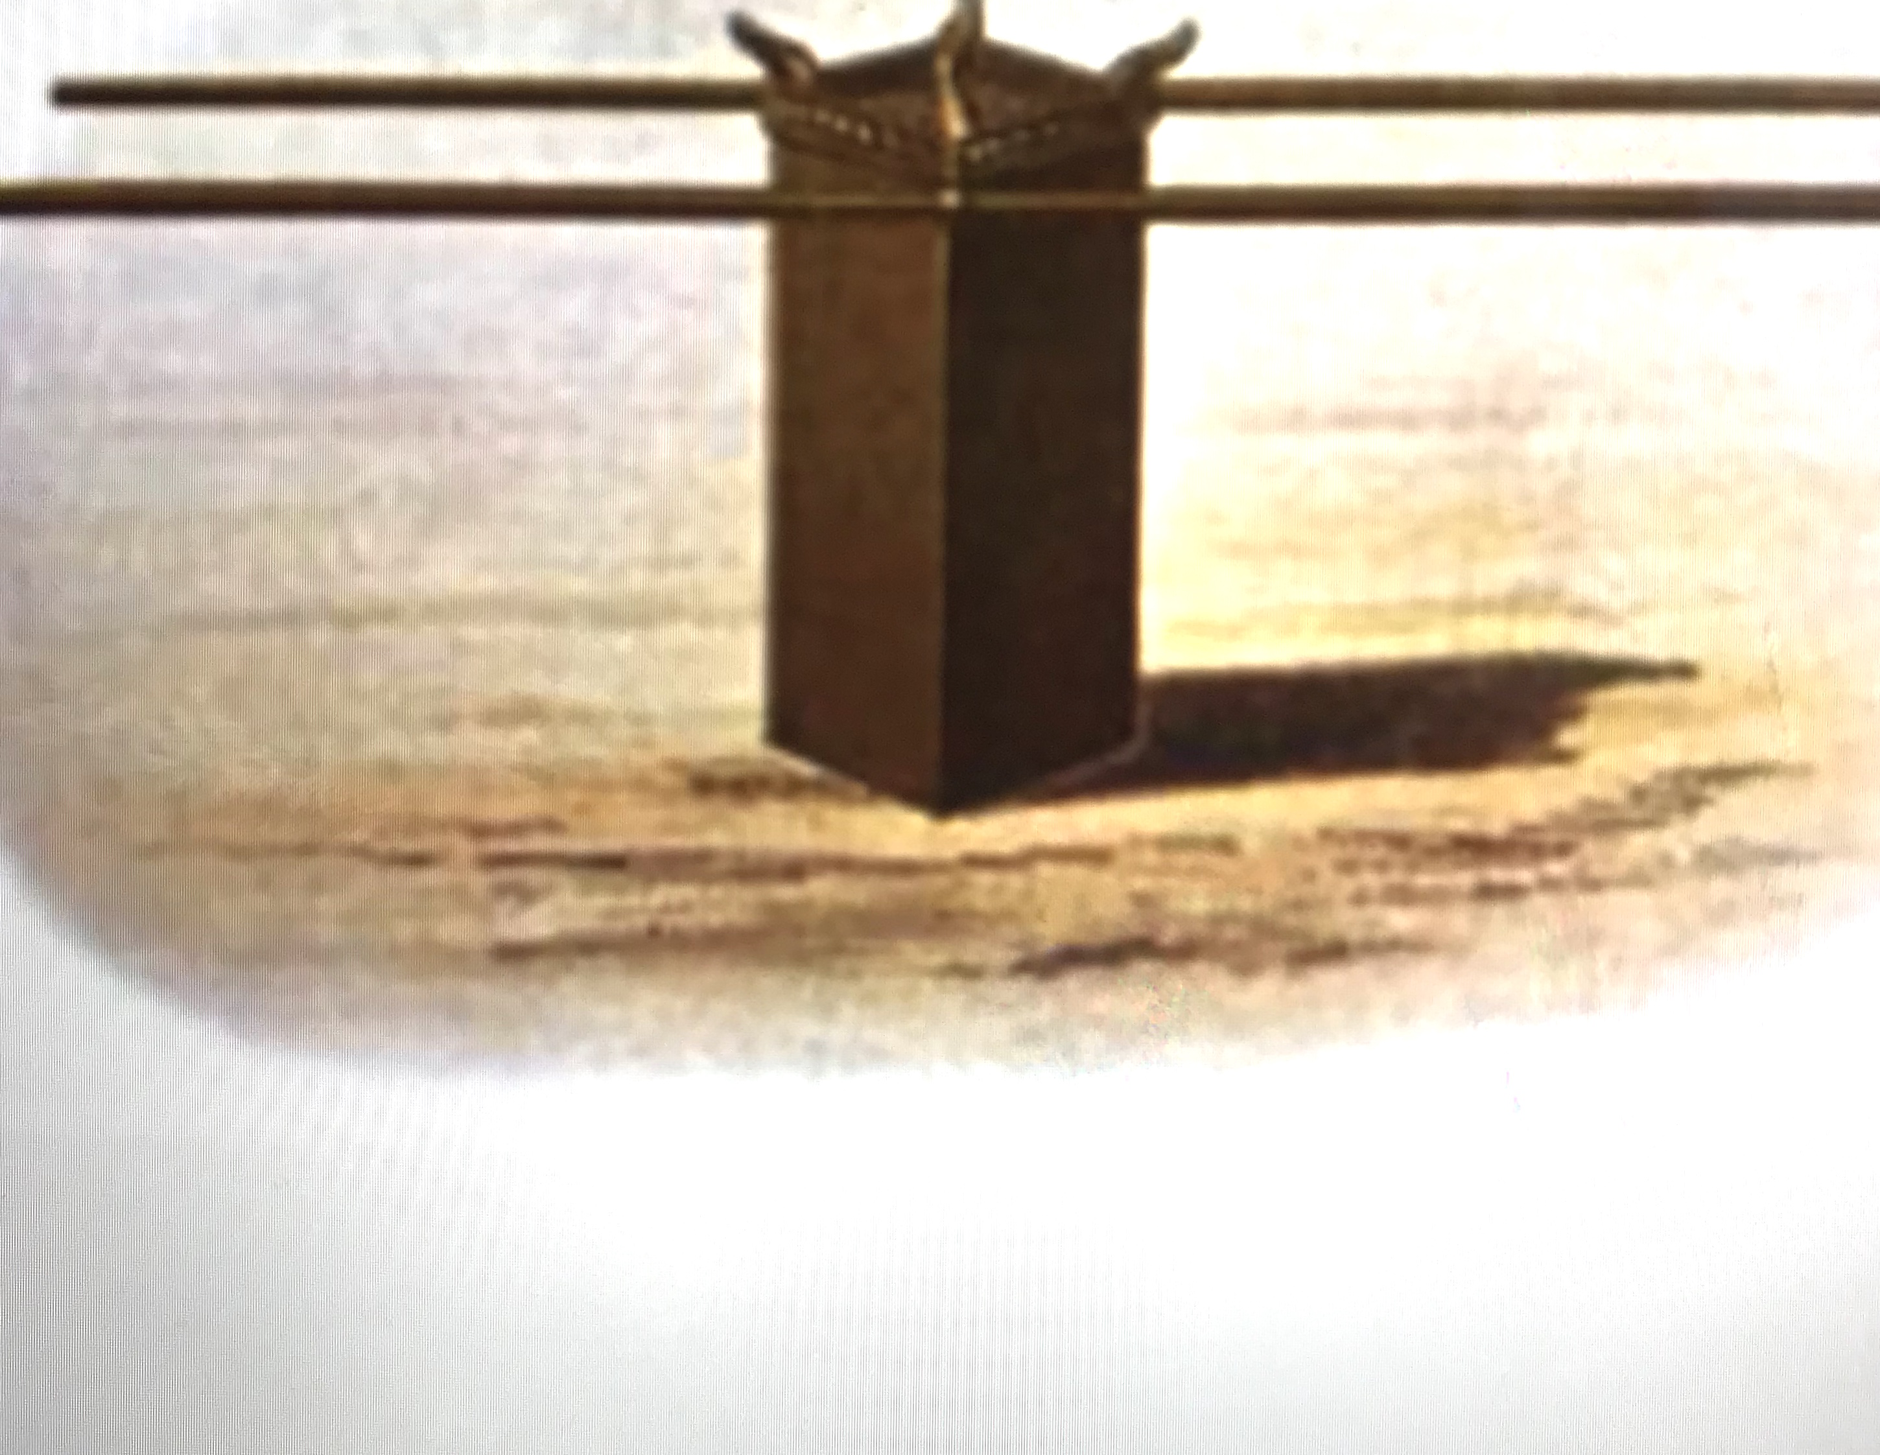
Altar of Incense
The gold altar of incense represents the intercession and the memorial of Jesus. While the golden lampstand was to burn perpetually, the bread of the Presence was to be replaced every Sabbath. The incense was to be burned every morning and evening.

Slide 26
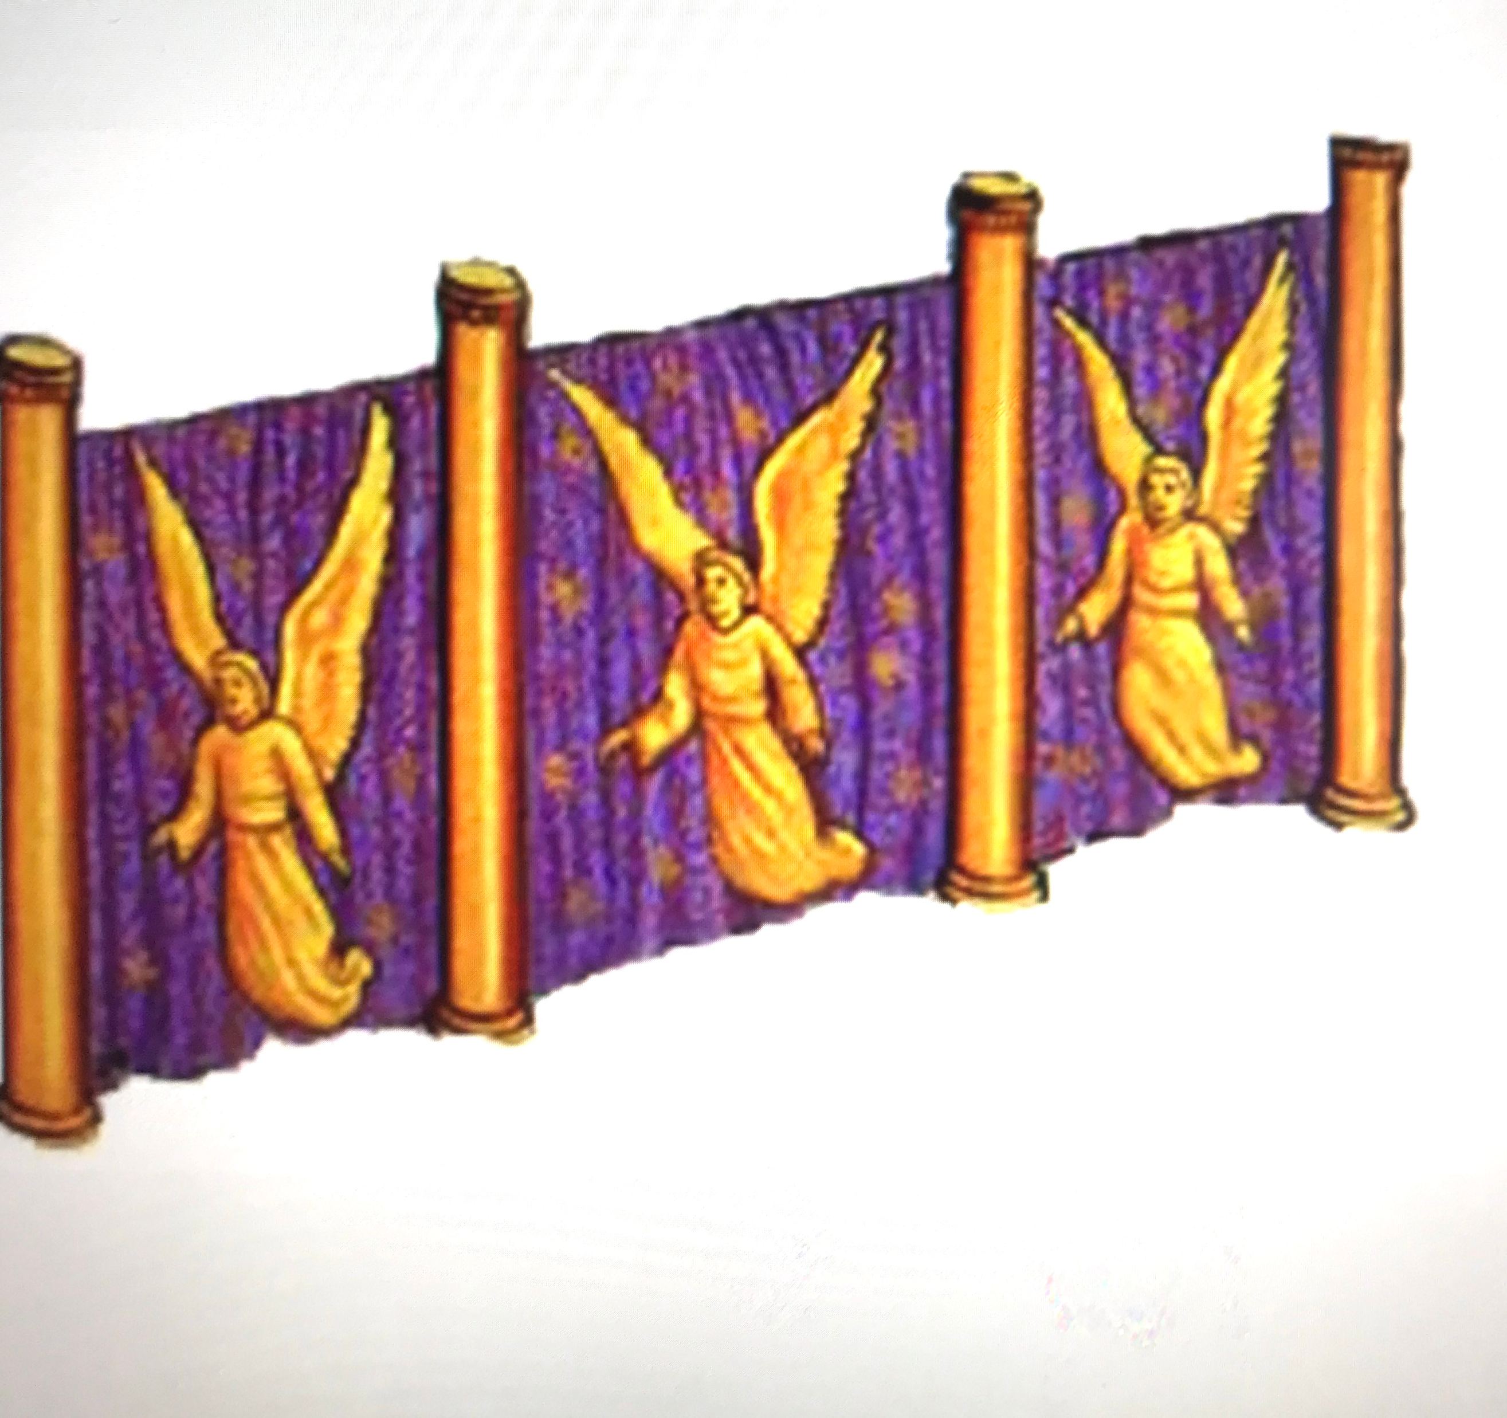
Veil
The second veil, the one separating the Holy Place from the Holy of Holies represents the flesh of Jesus’ body.

Slide 27
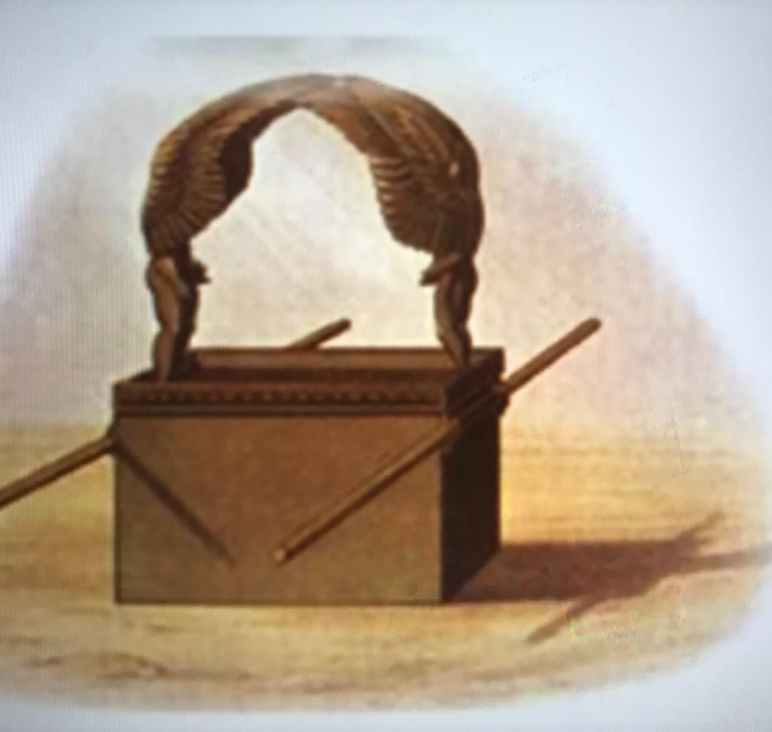
Ark and the Mercy Seat
The ark with the mercy seat is where God meets with men. It represents our meeting place in this life and the place of our eternal salvation.

Slide 28
QUIZzzzzz

Slide 29
WHAT’S INSIDE THE MERCY SEAT?

Slide 31
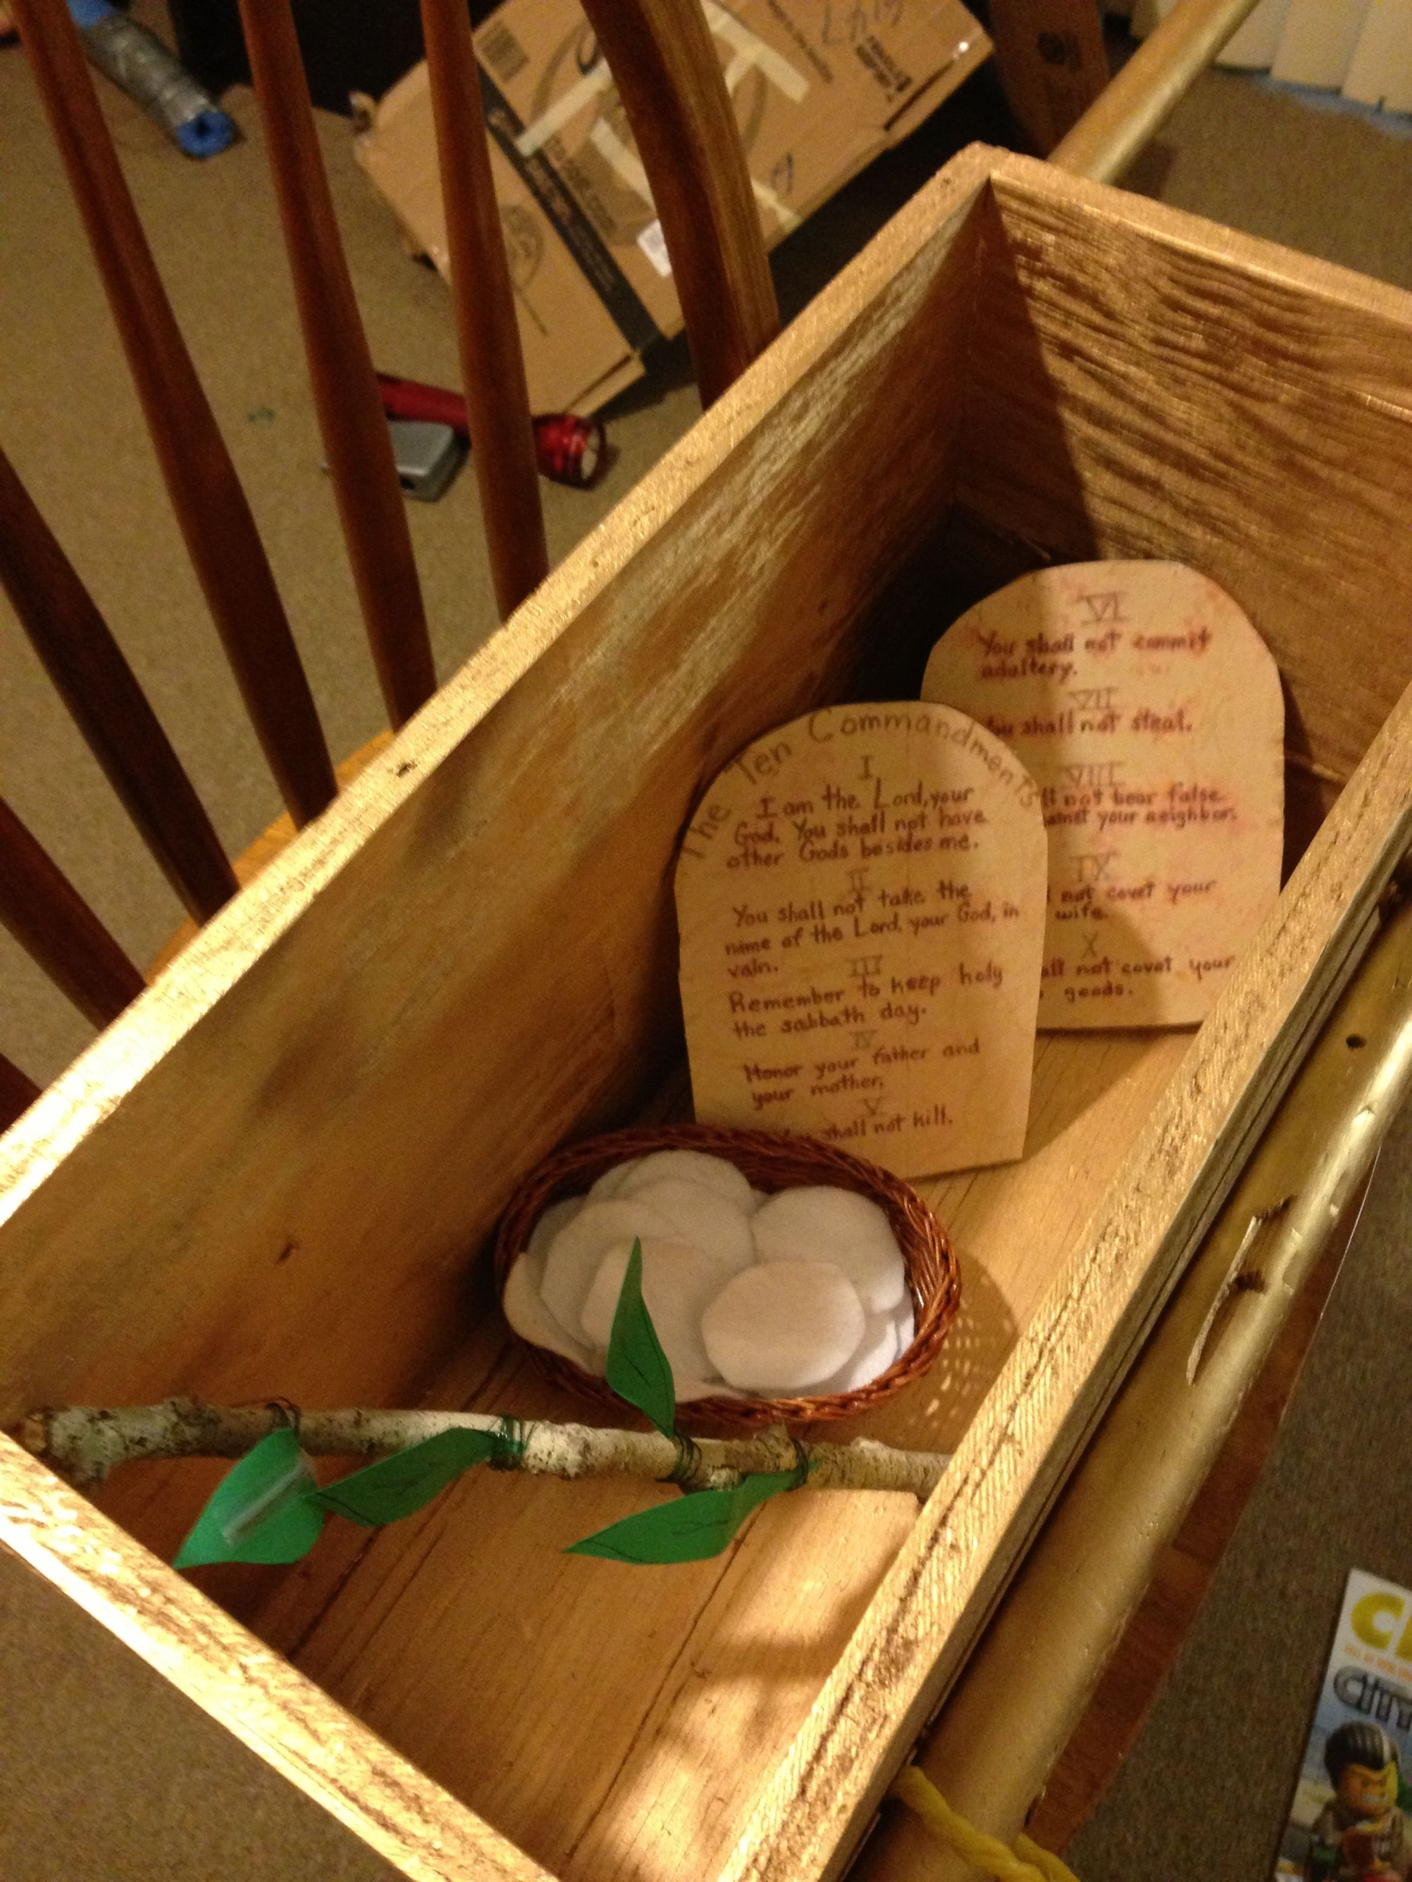
Hebrews 9:4 states that the Ark contained "the golden pot that had manna, and Aaron's rod that budded, and the tablets of the covenant.

Slide 32
Pictures of Salvation -
The tabernacle is a wonderful picture of Jesus.
The courtyard including the altar, laver and the posts that held the linen “fence” were made of bronze but the only metal inside the tabernacle was gold.
The bronze symbolizes sin and the gold symbolizes God.

Slide 33
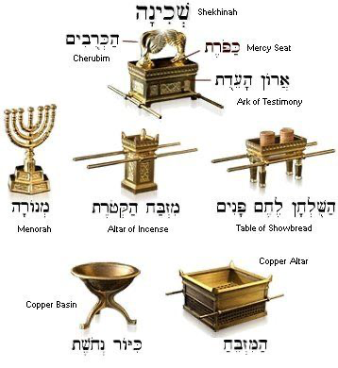

Slide 34


Slide 35
TOOLS
A4 Sheet card paper
Lolli Sticks
Pencils
Ruler
Tube of glue ( paper glue can work for now)
Colors – Markers / Crayons or Coloured pens

Slide 36
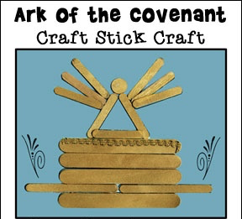

Slide 37
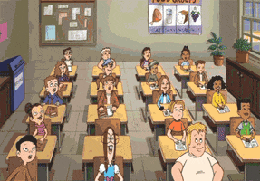
CLASS DISMISSED : Prayer Attention

