Slide 1
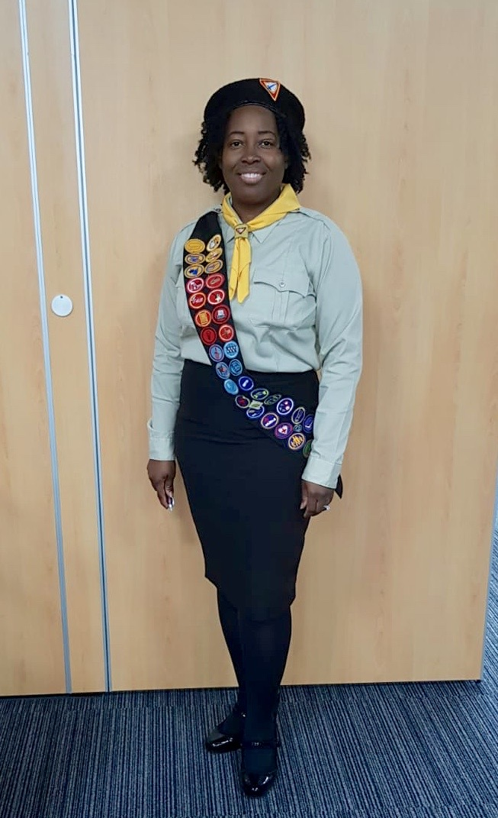
Hello HELPING HAND ADVENTURERS!
I am Your Instructor: DALE BYNG

Slide 2
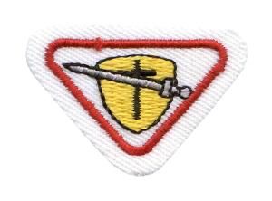
PRAYER WARRIOR AWARD

Slide 3
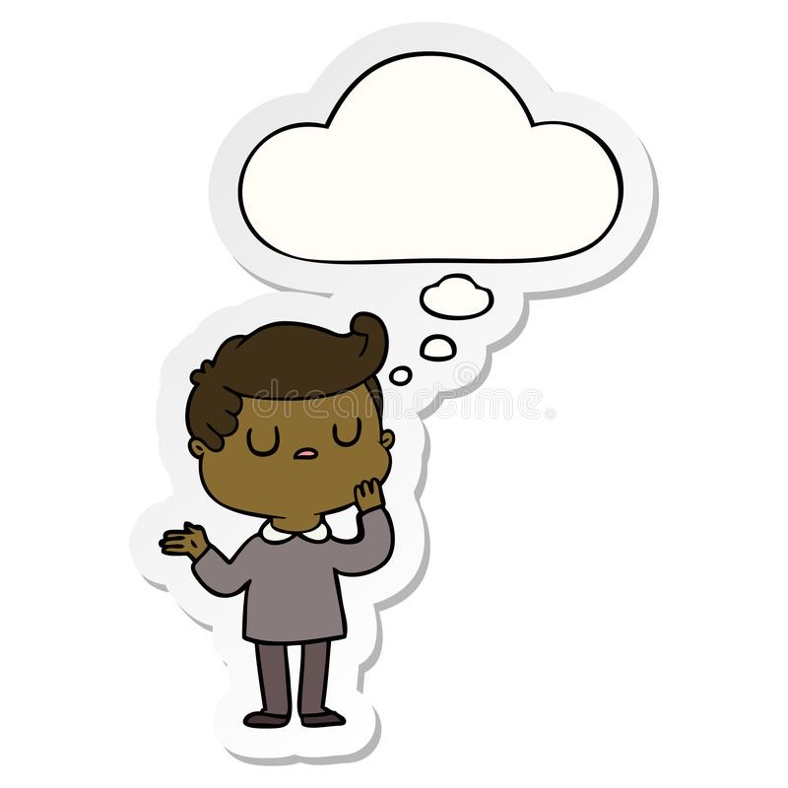
QUIZzzzzz

Slide 4
NAME SOME PRAYER WARRIORS MENTIONED IN THE OLD TESTAMENT OF THE BIBLE?

Slide 5
Abraham (Gen. 12)
Joseph (Gen.41)
Moses (Exodus 16)
Joshua (Joshua 5)
Gideon (Judges 6)
Samuel (I Samuel 3)
David (Psalm 41 & I Samuel 17)
Daniel (Daniel 6).3.

Slide 6
BIBLE VERSE: Ephesians 6:11-18
11Put on the whole armour of God, that ye may be able to stand against the wiles of the devil.12For we wrestle not against flesh and blood, but against principalities, against powers, against the rulers of the darkness of this world, against spiritual wickedness in high places.
13Wherefore take unto you the whole armour of God, that ye may be able to withstand in the evil day, and having done all, to stand.
14Stand therefore, having your loins girt about with truth, and having on the breastplate of righteousness;15and your feet shod with the preparation of the gospel of peace;16above all, taking the shield of faith, wherewith ye shall be able to quench all the fiery darts of the wicked.17And take the helmet of salvation, and the sword of the Spirit, which is the word of God:18praying always with all prayer and supplication in the Spirit, and watching thereunto with all perseverance and supplication for all saints;

Slide 7

SING ALONG

Slide 8
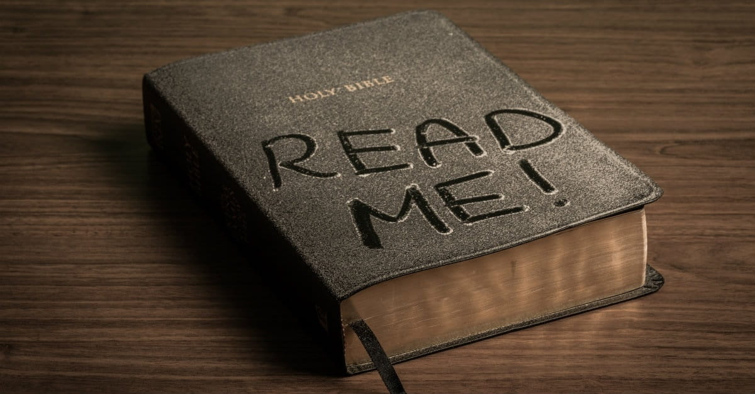

Read your Bible.Pray every day (repeat 3 times).
Read your Bible.Pray every day.
And you’ll grow, grow, grow (repeat 3 times).
Read your Bible.Pray every day.And you’ll grow, grow, grow.
Don’t read your Bible.Forget to pray (repeat 3 times).
Don’t read your Bible.Forget to pray.
And you’ll shrink, shrink, shrink (repeat 3 times).Don’t read your Bible.
Forget to pray.And you’ll shrink, shrink, shrink.

Slide 9
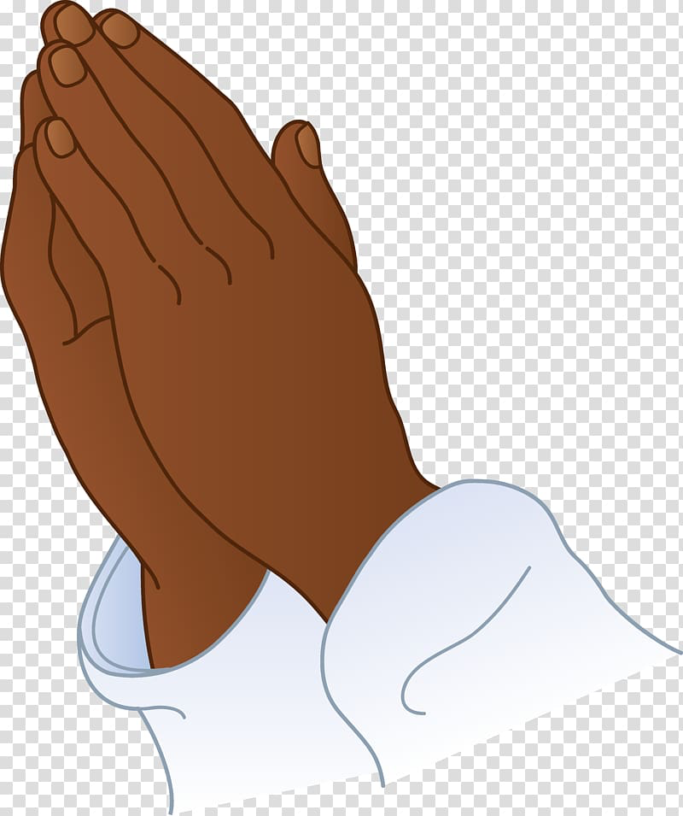
WHY DO WE PRAYER ???

Slide 10


Slide 11
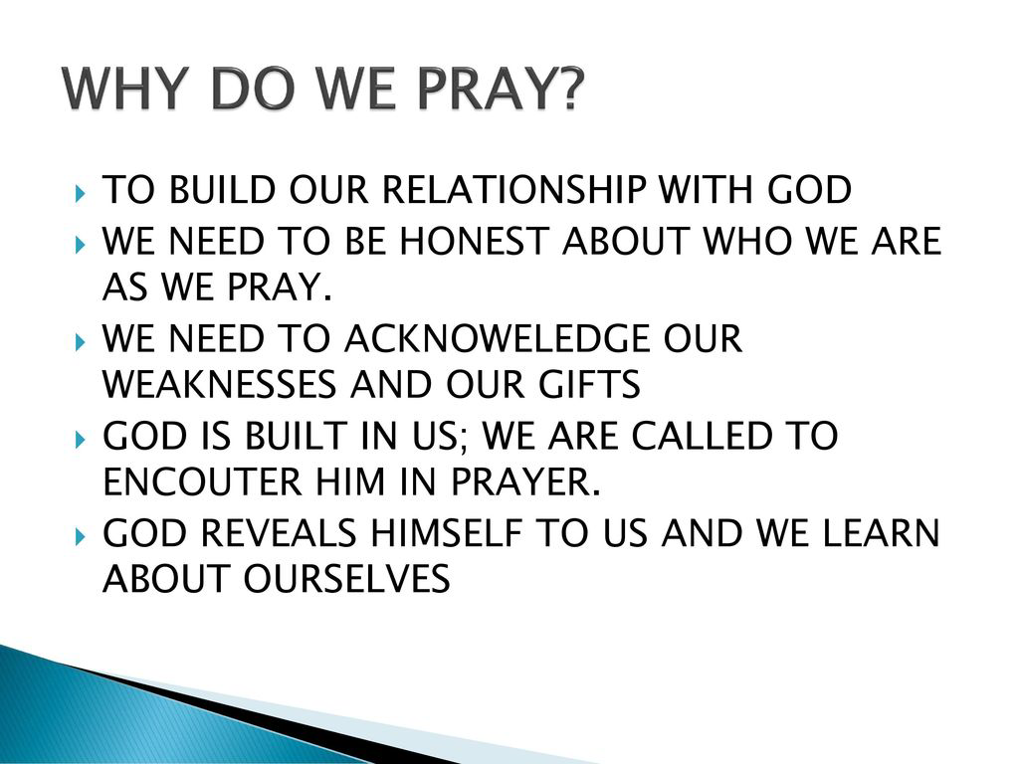

Slide 12
HOW DO WE PRAYER ???

Slide 13
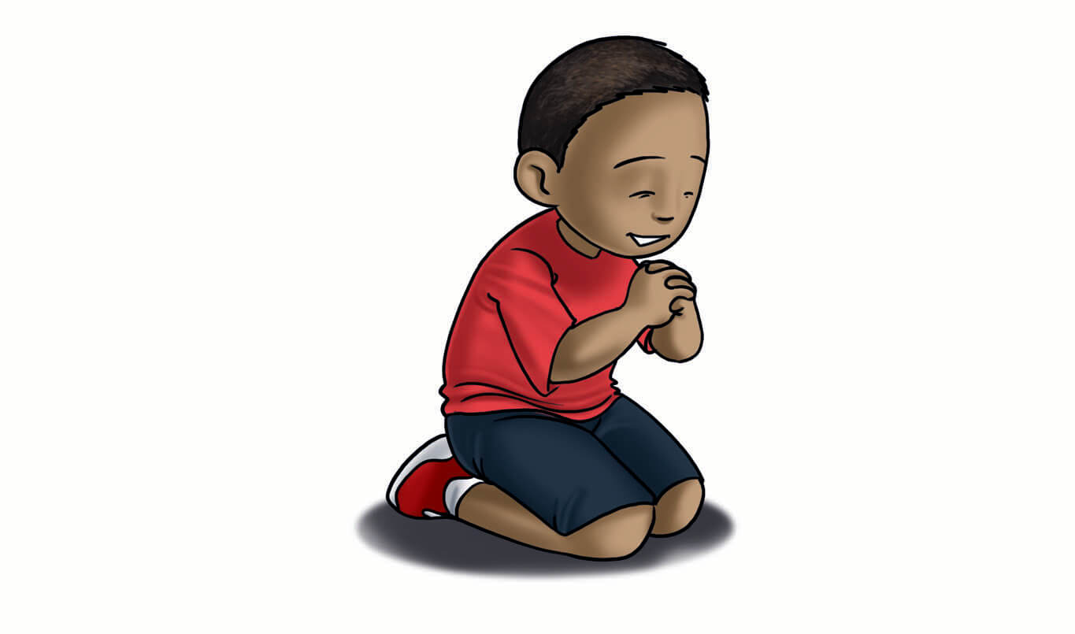
SPENDING TIME WITH GOD – IS IT ONLY ON OUR KNEES???

Slide 14
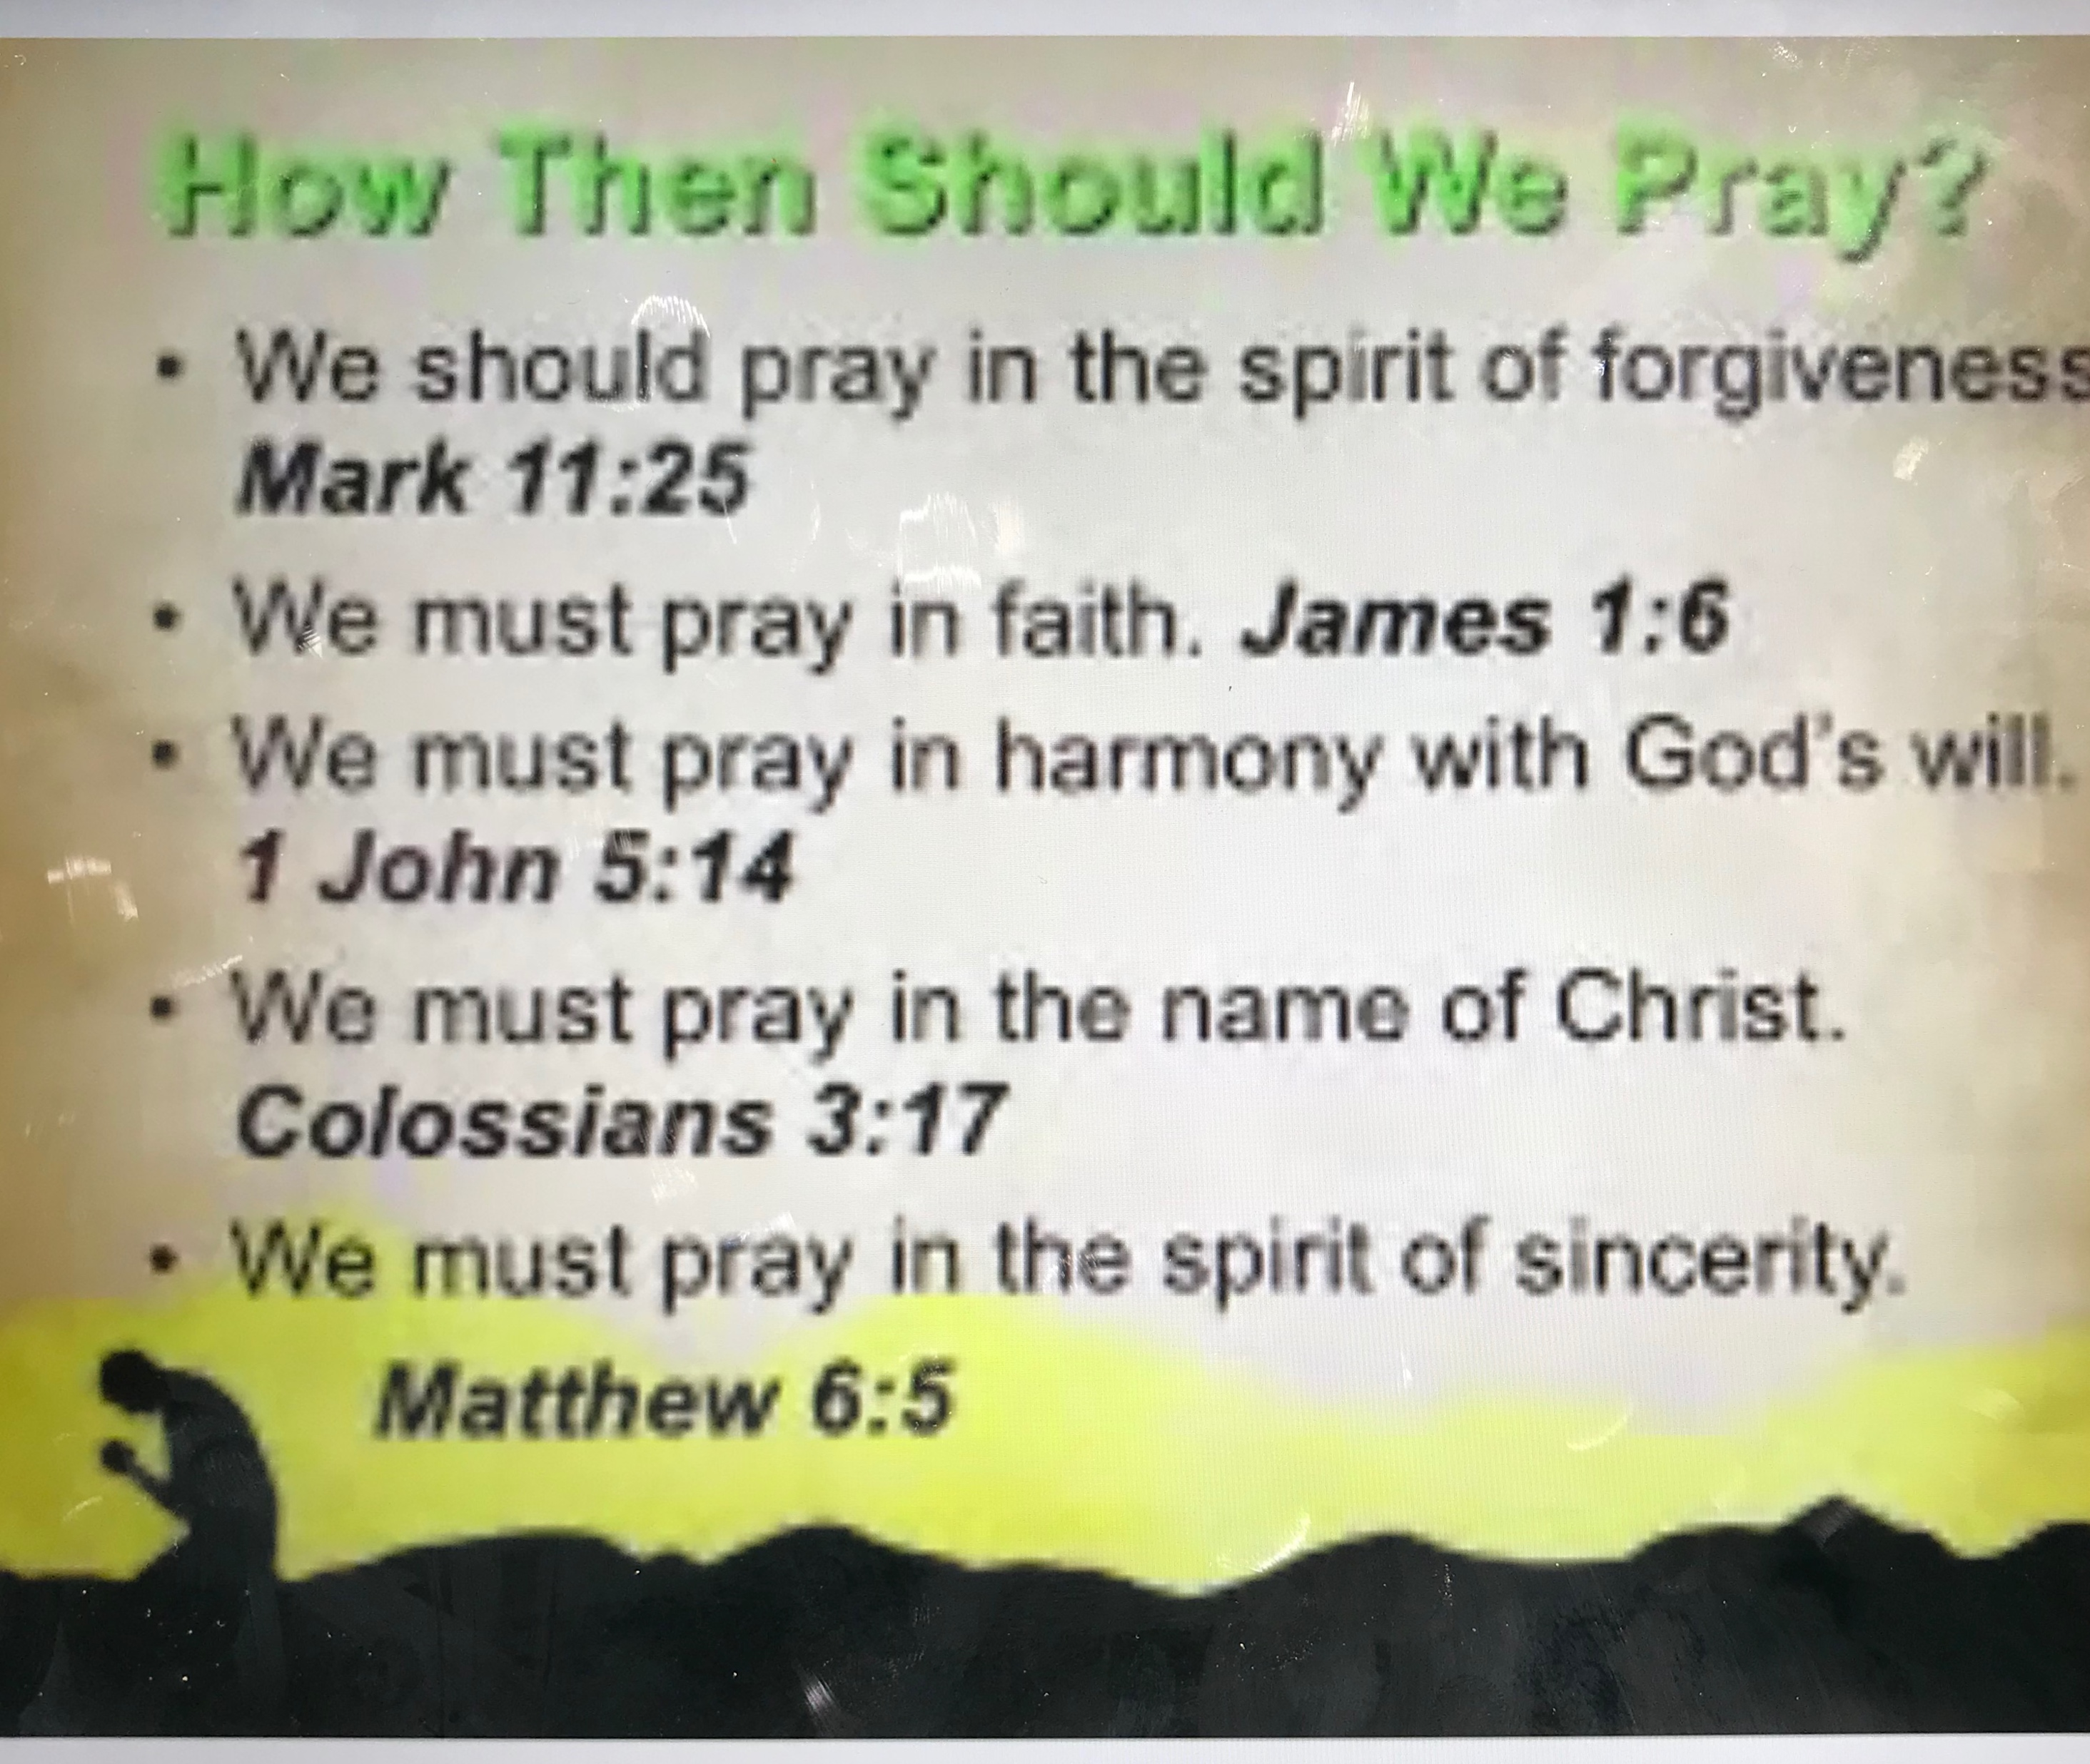

Slide 15
QUIZzzzzz

Slide 16
Say the part in the Adventurer LAW that Reminds us How to PRAYER???

Slide 17
BE REVERENT

Slide 18


Slide 19
WHERE DO WE PRAYER ???

Slide 20
The ideal location to pray at, if a place can be found that is quiet and offers some privacy - (Matthew 6:6).
The early church of God often communed with the Father either in the homes of brethren or in rooms of various sizes (Acts 1:13 - 14, 24 - 25, 12:5, 15

Slide 21
The Bible records an amazing variety of places where prayer was uplifted
Jesus was known to pray on the side of a mountain (Matthew 14:23, Mark 6:46, Luke 6:12, 9:28).
The fighting men of three Israelite tribes cried out to the Eternal and their prayer was heard when they were on a battlefield (1Chronicles 5:18 - 20).

Slide 22
One time Peter made his supplications known on a friend's roof (Acts 10:9).
Petitions have been offered by the side of a river (Acts 16:13), in wilderness areas (Luke 5:16), and in a beautiful garden (Matthew 26:36, Mark 14:32, Luke 22:45).

Slide 23
QUIZzzzzz

Slide 24
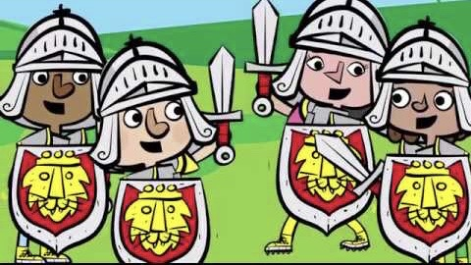
NAME THE PARTS OF THE ARMOUR OF GOD & WHAT DO THEY REPRESENT?

Slide 25
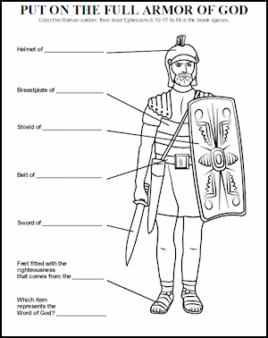

Slide 26
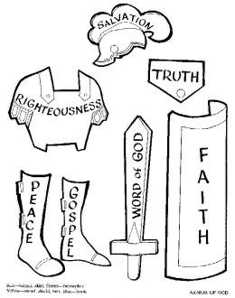

Slide 28
SPENDING TIME WITH GOD

Slide 29
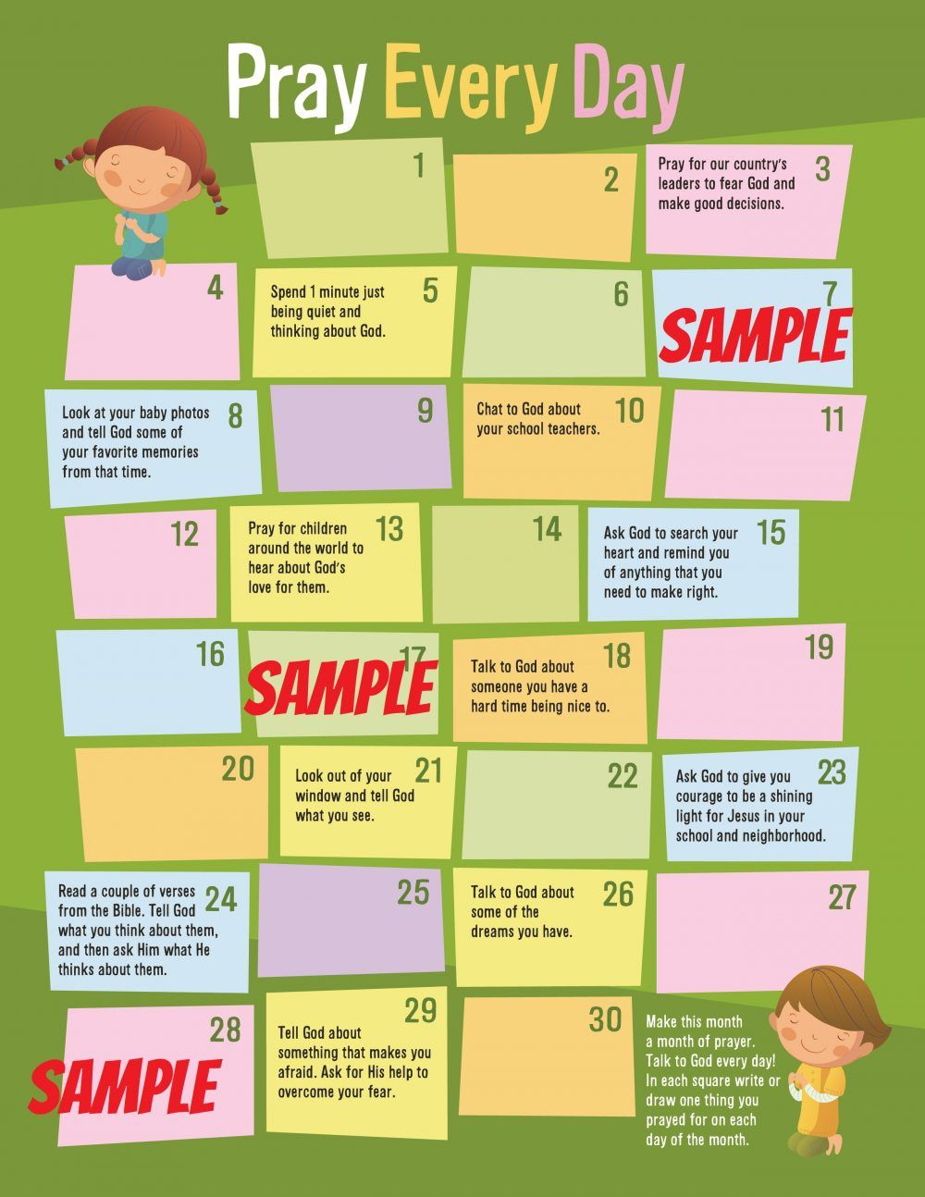

Slide 30


Slide 31
TOOLS
Plain & Coloured A4 paper
Pencils
Foil
Glue / Tape
Pair of Scissors
Colour– Markers / Crayons or Coloured pens

Slide 32
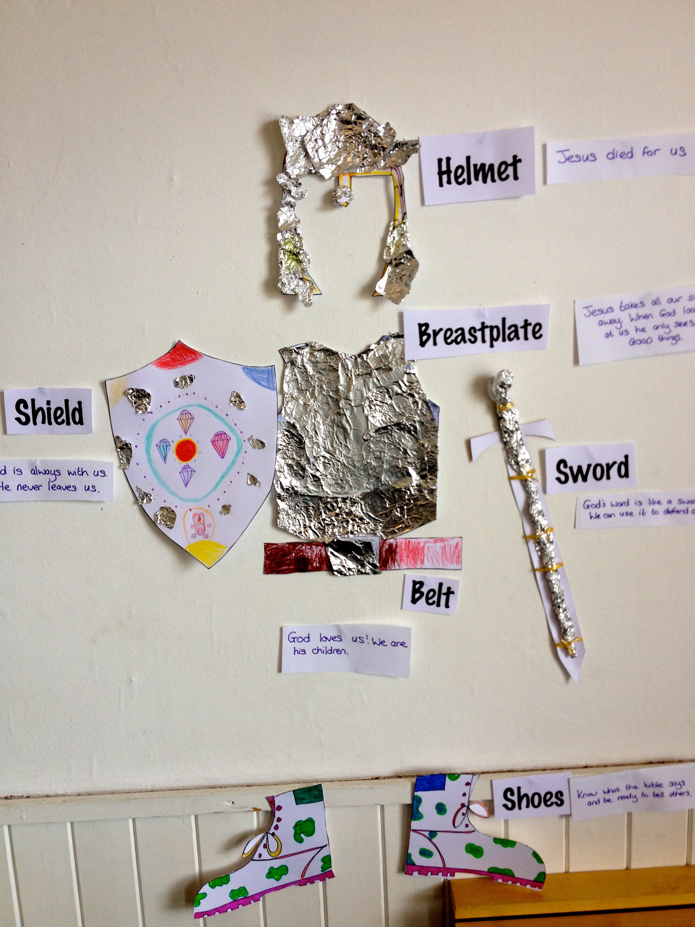

Slide 34
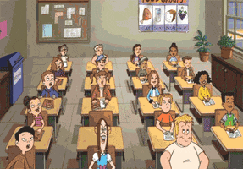
CLASS DISMISSED : Prayer Attention

