Slide 1
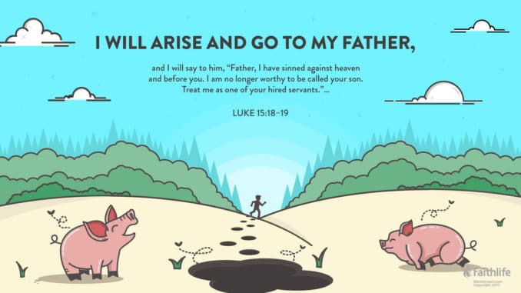
The wastefully extravagant son
THE PRODIGAL SON

Slide 2
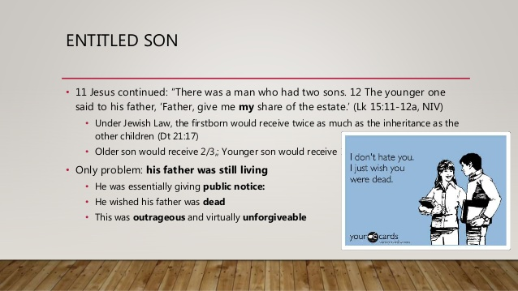

Slide 3
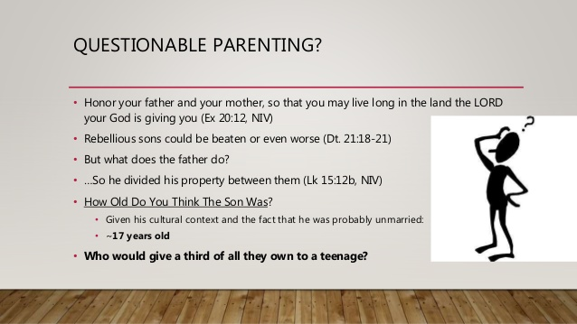

Slide 4

NO SENSE TO NO CENT

Slide 5

IN WANT
THE RECESSION:THERE IS BOUND TO BE A SEASON OF RAIN
(VS. 14)

Slide 6


Slide 7
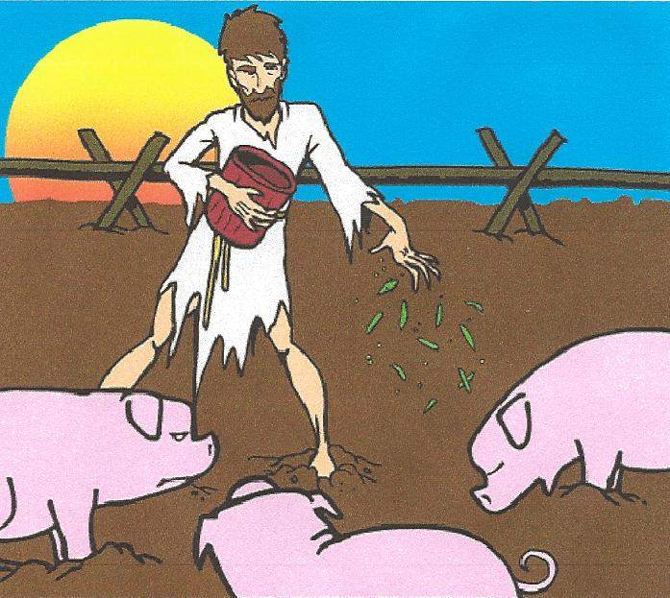
FALLEN FROM GRACE

Slide 8

IT IS OFTEN SAID THAT WE DON’T LOOK UP AT GOD UNTIL WE ARE ON OUR BACKS

Slide 9

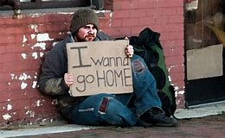

Slide 10

1 JOHN 1:9

Slide 11
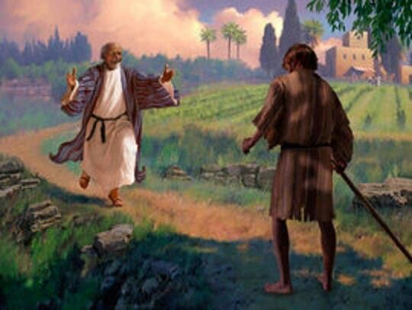
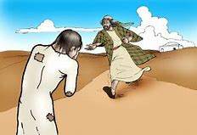

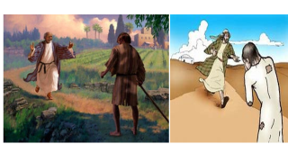


Slide 12
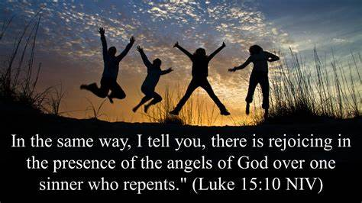

Slide 13

ACTION SPEAKS LOUDER THAN WORDS

Slide 14


Slide 15
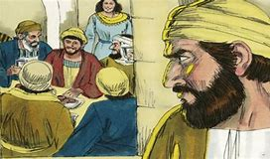

Slide 16
! THE LESSON
The message of the prodigal son is a message of forgiveness & redemption. The story of the prodigal son is one of first:
pride,
second wild living
third failure
finally realization that repentance is required for a clean start.

Slide 17
THE INVITATION
MATT. 11:28,29

Slide 18
The invitation of Jesus still stands.
To anyone who has gone their own way but now wants to return back to their Amazing, Gracious Father through Jesus Christ:
He’s waiting for you. This invitation for you.
To anyone who is not necessarily lost but is hoping to find a new deeper meaning with Christ.
Church/home – a church family where they can be nourished and encouraged — a family ultimately led by our Amazing, Gracious Father, this invitation is for you. The invitation is for all.

Slide 19
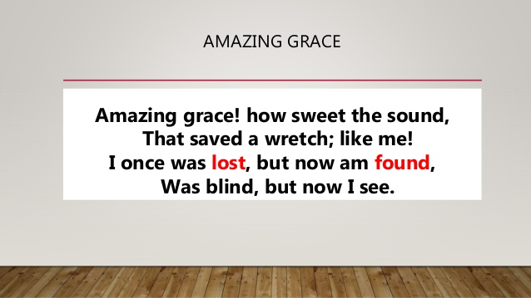

Slide 20


