Slide 1
IS IT WORTH THE RISK?

Slide 2
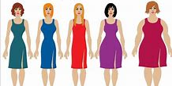
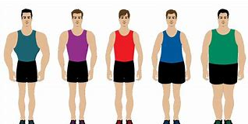
MY BODY VS
ALCOHOL & DRUG ABUSE

Slide 4
1 CORINTHIANS 6:19,20
Do you not know that your bodies are temples of the Holy Spirit, who is in you, whom you have received from God? You are not your own; ²⁰you were bought at a price. Therefore honor God with your bodies.

Slide 5
SO THEN!

Slide 6
THE STATISTICS
In 2018/19 there were 358 thousand estimated admissions where the main reason for admission to hospital was attributable to alcohol.
This is 6% higher than 2017/18 and 19% higher than 2008/09.
In England in 2018, there were 5,698 alcohol-specific deaths which is 2% lower than 2017 and an increase of 7% on 2008.
Note: a further 1,920 deaths were also due to unspecified hepatitis and fibrosis and cirrhosis of the liver(Which is due to alcohol consumption).

Slide 7
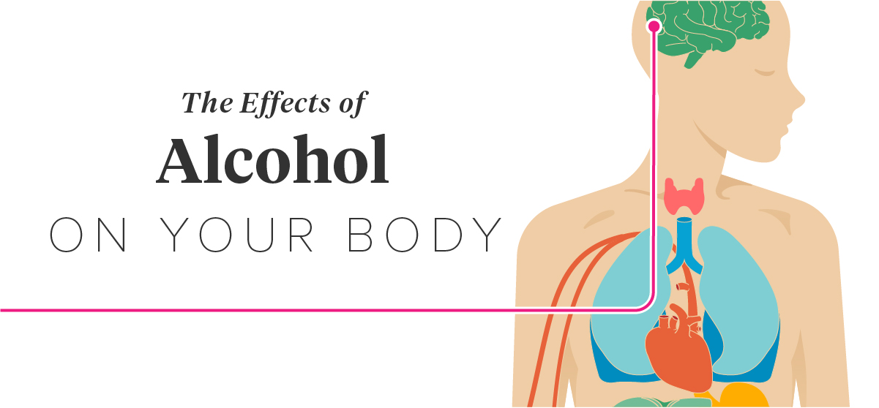

Slide 8
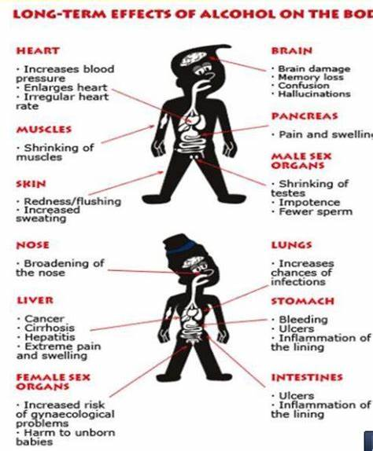

Slide 9
AN UNFORGETABLE SABBATH STORY

Slide 10
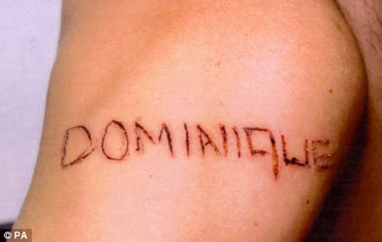

Slide 11
DEFINITION OF A PROVERB
A PROVERB IS A SHORT, WELL-KNOWN SAYING, STATING A GENERAL THRUTH OR PIECE OF ADVICE

Slide 13
https://youtu.be/WXbttnDkp7E

Slide 14
BEN CARSON
Ben Carson in his book on Risk says this;
‘’Some individuals who take all the wrong risk and tragically end up hurting or destroying themselves or others in the process’’.
There are things out there that just aren’t worth the risk’

Slide 15
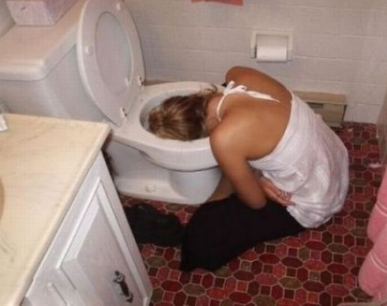
IS IT REALY WORTH
IT
???????????

