Slide 1
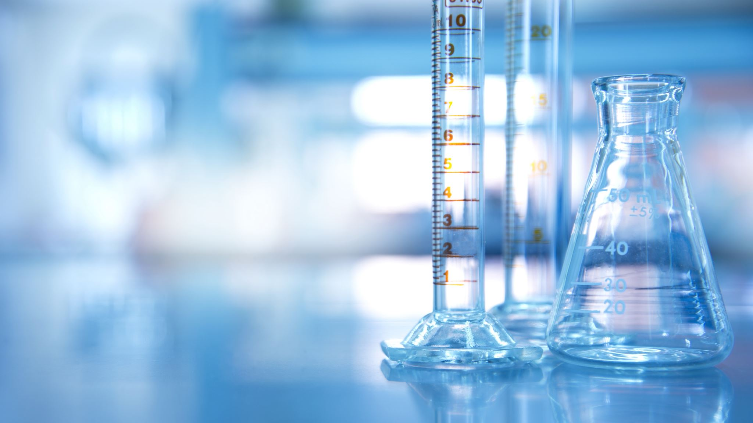
Chemistry

Slide 2
Requirement 1

Slide 3
Define the following:
Elements consist of atoms with the same atomic number
1
Atoms join together to make compounds
2
An abbreviation of representing an element e.g H represents Hydrogen
3
A mixture of two or more substances that do not chemically react
4
Elements
Compounds
Chemical Symbols
Solutions

Slide 4
Define the following:
Atoms are really small and contain protons, neutrons and electrons
1
Two or more atoms that have bonded to each other
2
A tabular method of displaying the chemical elements.
3
The chemical process of a fuel combining rapidly with an oxidizer e.g. burning
4
Atoms
Molecules
Periodic Table
Combustion

Slide 5
Define the following:
Chemical agents that release hydrogen ions when added to water
1
A term for the solid form of an ionic compound e.g. Sodium Chloride
2
A positively charged particle that is a part of the nucleus
3
A neutrally charged particle that is a part of the nucleus
4
Acid
Salt
Proton
Neutron

Slide 6
Define the following:
The process of purifying a liquid by heating or cooling
2
A process of seperating a mixture of chemical compounds
3
The action or process of filtering something
4
A negatively charged particle
1
Electron
Distillation
Fractional Distillation
Filtration

Slide 7
Requirement 2

Slide 8
What gases extinguish life and how?
Explain the principle of one kind of chemical fire extinguisher
1. Suffocation – The gas displaces oxygen and then body now starved of oxygen dies
2. Poisons – There are gases such as Cyanide gas HCN which are highly poisonous
3. Explosion – Many gases are quite flammable and can explode quite destructively
Fire extinguishers work by smothering the fire

Slide 9
Requirement 3

Slide 10
Two common sources of carbon monoxide
Why is it dangerous?
1. Gas Stoves and dryers
2. Clothes dryers
It is harmful when breathed because it displaces oxygen in the blood and deprives the heart

Slide 11
Requirement 4

Slide 12
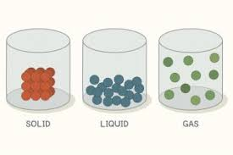
States of Matter
Solid
Liquid
Gas

Slide 13
Requirement 5

Slide 14
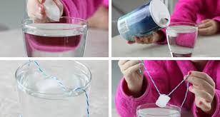
Ice cube Experiment
Equipment :
Ice
Salt
Water
Glass
String
Method:
1. Put the ice cube in the glass
2. Tie a loop on the string and place it on the cube
3. Put a pinch of salt on the loop and cube
4. Wait a while then pull up the string

Slide 15
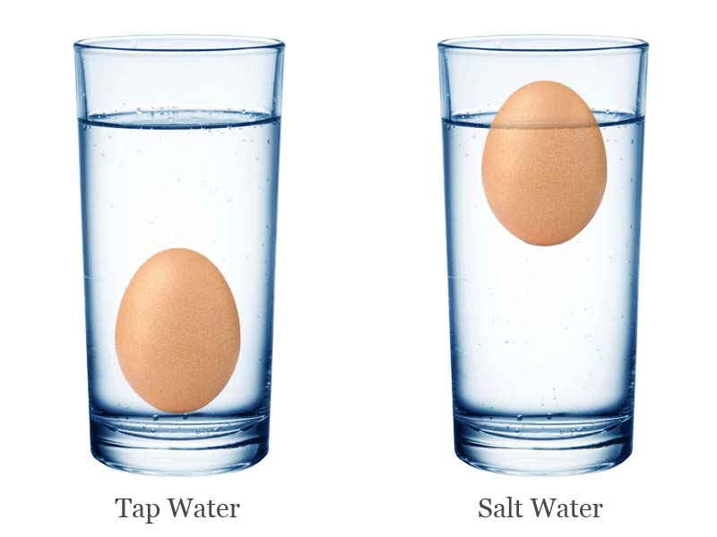
Egg experiment
Equipment
Fresh (uncooked) egg
1 litre water
120ml sat
2 Bowls
Method
1. Add the salt and a half litre of water to a bowl and sitr until the salt dissolves
2. Add the other half litre of water to the other bowl – do not add any salt
3. Place the egg in the salted water. It should float
4. Move the egg to the unsalted water. It should sink

