Slide 1
MASTER
GUIDE
Masterguide In Training
(M.I.T)

Slide 2
Baptized member in regular standing;
Written recommendation from the local church board – NEW for 2017;
At least 16 years old to start the programme. At least 18 years old to be invested;
Active staff member of an Adventurer & Pathfinder club – NEW for 2017;
Complete Basic Staff Training (BST) and be involved for a minimum of one year in either Adventurer & Pathfinder ministries.

Slide 3
Programme Modules:
Spiritual Development;
Skills Development;
Child Development;
Leadership Development;
Fitness Lifestyle Development

Slide 4
LEADERSHIP SEMINARS
How to be a Christian leader;
Vision, Mission & Motivation;
Risk Management for Adventurer & Pathfinder Ministries;
Discipline.

Slide 5
COMMUNICATION SEMINARS
Communication theory & listening skills;
Practical communication practices;
Understanding and teaching to learning styles.

Slide 6
CREATIVITY & RESOURCES
SEMINARS
How to prepare effective creative worship;
Understanding and using creativity.

Slide 7
CHILD EVANGELISM SEMINARS
Principles of youth & children’s evangelism;
How to lead a child to Christ;
Understanding your spiritual gifts.

Slide 9
Spiritual Development
Spiritual Development
Spiritual Development

Slide 10
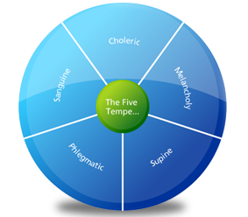
New Spiritual Development Requirements
Temperament
Analysis
Community
Outreach

Slide 11
None should consent to be mere machines, run by another man’s mind. God has given us ability to think and to act, and it is by acting with carefulness, looking to Him for wisdom, that you will become capable of hearing burdens. Stand in your God-given personality. Be no other person’s shadow. Expect that the Lord will work in and by and through you.
- Ellen G White in The Ministry of Healing page 498,499

Slide 12
Course Content:
Session 1 - Try Him and See
Session 2 - You Can Have It Now!
Session 3 - It’s All about Surrender
Session 4 - God’s Ultimate Temple
Session 5 - You Can Do It Too
Session 6 - We Are the Body
Session 7 - Equipped for Ministry

Slide 13
Child Development
Child Development
Child Development

Slide 14
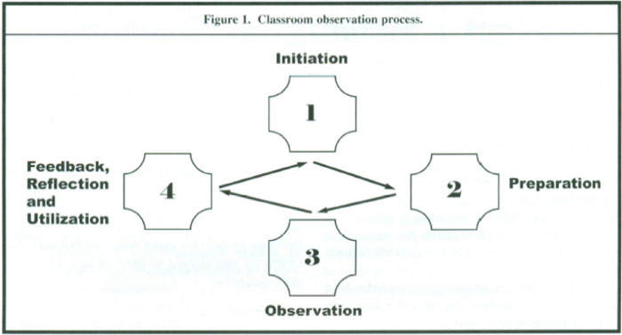

Slide 15
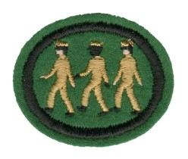
HONOURS
Christian Storytelling
Camping Skills 1
Camping Skills 2
Camping Skills 3
Camping Skills 4
Drilling &
Marching
Knot Tying

Slide 16
Contact Details
Carolyn Daniel
cdani@sky.com
0744 381985
Name
Email
Telephone

