Slide 1
Basic Staff Training: Training the Trainer
Disability Awareness

Slide 2
Objectives
The Models of disability
Disability definition
Barriers to access
Statistics
Types of disabilities
Action planning – What do I need to do now? What are my concerns?

Slide 3
Let’s go!
Numbers

Slide 4
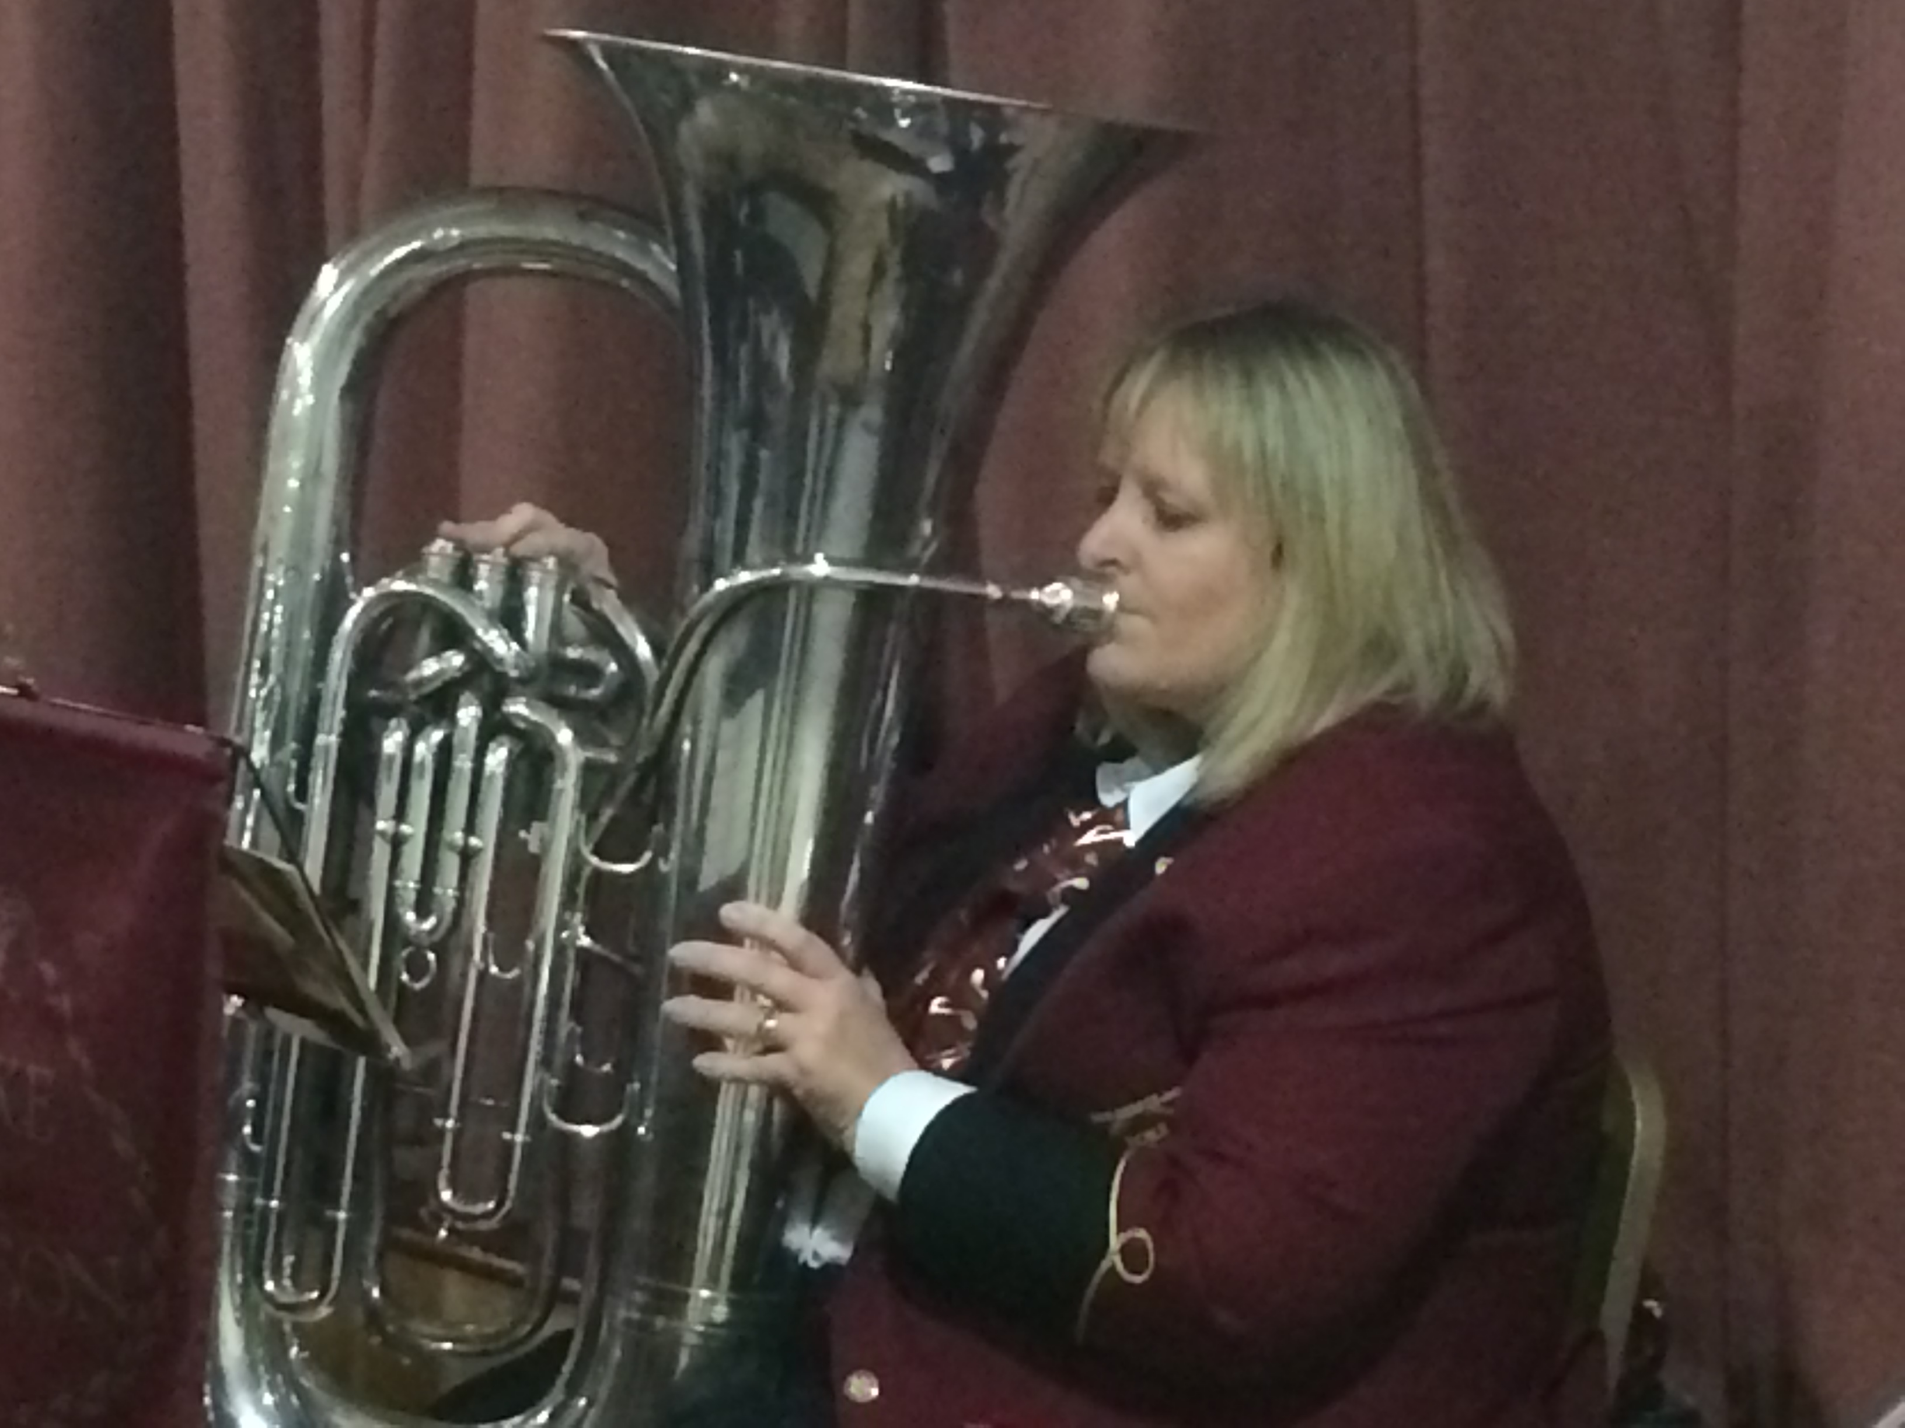
Hi
Next person to you – one thing they would NOT know about you!

Slide 5
?
Something nobody would know about you
1 thing you are hoping to gain from the session.
Write it down
Post on yellow sheet and stick up on wall

Slide 6
ASNA??
ASNA a church department
Registered charity

Slide 7
ASNA
All churches should have a ASNA REP
All church should have a Disability Coordinator

Slide 8
How many people manage ASNA
20
9

Slide 9
How is ASNA financed
Donations
External grants from Trusts and Foundations
Both

Slide 10
Surname of one of the trustees
Brown
Springer

Slide 11
Disability?
Notes:
Write on pad no conferring. Write on yellow sheet. Put up on wall. Circle all negative words

Slide 12
Perspectives of disability

Slide 13
Medical Model of disability
Disabled people need fixing or care, charity.
People become dependant and lose dignity
Commonly used in some health care practices
Some churches still adhere to this model
Notes:
Does he take sugar, see the disability before you see the person

Slide 14
Social model of disability
The social model describes disability as...
...all the things that impose restrictions on disabled people;
individual prejudice to institutional discrimination,
from inaccessible public buildings to
unusable transport systems,
from segregated education to excluding work arrangements, and so on.

Slide 15
Social Model of disability
The social model’s focus is on society to:
change policy,
Change attitudes and
Change economic discrimination against disabled people.
Limitations forget that some people still experience physical pain & emotional stresses.

Slide 16
Models of disability
Medical Model
Focuses on limitations, inabilities and on the medical details of disability
Assumes disabled people have a ‘problem’ which needs to be ‘fixed’ or cured.
Results in disabled people being seen as dependent.
Social Model
Focuses on effects that society and poor built environment creates: marginalisation and lack of access.
Assumes that society and the built environment need to be changed to enable disabled people to participate fully
Results in independence.

Slide 17
Medical model Vs Social models

Slide 18
Interdependency Model
As we are drawn into relationship with our creator, we are drawn towards one another.
We are drawn into ‘community’.
We are made for relationship!
We all need each other!

Slide 19
The Bible and Disability
What does the Bible say about Disability?

Slide 20
What does the Bible say about disability?
Bible passage | Key message
Genesis 1:27 | Group 1
1 Samuel 16:7 | Group 2
Psalm 139:14 | Group 3
John 9:1-3 | Group 1 & Group 4
1 Cor 12:12-22 | Group 2
2 Cor 12:5-10 | Group 3
Galatians 3:28 | Group 4

Slide 21
What does the Bible say about disability
Bible passage | Key message
Genesis 1:27 | We are all made in God’s image
Exodus 4:10-16 | God is Sovereign and doesn’t make mistakes
1 Samuel 16:7 | The Lord looks at the heart
2 Samuel 9 | There is a place at the King’s table for disabled people
Psalm 139:14 | We were fearfully and wonderfully made
Luke 5:17-26 | A distinction between the act of healing and forgiveness of sins
John 9:1-3 | Disability is not the result of sin
1 Cor 1:26-29 | God chooses the foolish things of the world
1 Cor 12:12-22 | Every Christian has a role to play, regardless of perceived weakness
2 Cor 12:5-10 | God’s power is made perfect in weakness
Galatians 3:28 | All are equal in Christ

Slide 22
Perspectives of disability: The Image of God
Gen 1:27
Col 1:15
2 Cor 3:18
1 John 4:7 – 21

Slide 23
Made in the image of God
Genesis 1:27 – we are made in His image,
Statement - every human being reflects something about who God is.
Each person is worthy of respect and dignity because each person has been made by God to convey something unique about God to the world
God attaches a high degree of worth on us all regardless of race, religion, ability.

Slide 24
Made in the image of God
Invitation to discover the image of God in each other
Col 1:15 – Jesus came to show the invisible God. We are to be like Him to discover what it means to be made in His mage.
It poses a challenge to treat people as if they are made in the image of God rather than anything less.

Slide 25
The Image of God
2 Cor 3:18 – we become changed into a likeness of God when we come to know Him
1 John 4:7 – 21 – God is Love (Vs 12)

Slide 26
God is love (1 John 4:8, NLV). Love is not an attribute of God, it is a statement about what and who God is. But how do we know
what love looks like? The answer? Through our relationships, our family, our associates, our friendships. We cannot learn what loves looks like unless it is embodied in action.

Slide 27
Theological model
Likening the Church to the human body Paul, the apostle, wrote: "those parts that seem to be weaker are indispensable." - the Church is losing out when it fails to include those parts.
A Church that fails to include disabled people is itself disabled.
We are all part of the body of Christ each with our own part to play.
Made in the image of God.

Slide 28
Models of Disability
4 Models of Disability ?

Slide 29
Models of Disability
Medical
Social
Interdependency
Theological

Slide 30
Basic Staff Training: Training the Trainer
Disability Awareness

Slide 31
Disability?

Slide 32
Definition of Disability
Equality Act 2010 defines a disabled person as someone who has a physical or mental impairment that has a substantial and long-term adverse effect on his or her ability to carry out normal day-to-day activities.

Slide 33
Further details on definition
substantial means neither minor nor trivial
long term means that the effect of the impairment has lasted or is likely to last for at least 12 months (there are special rules covering recurring or fluctuating conditions)

Slide 34
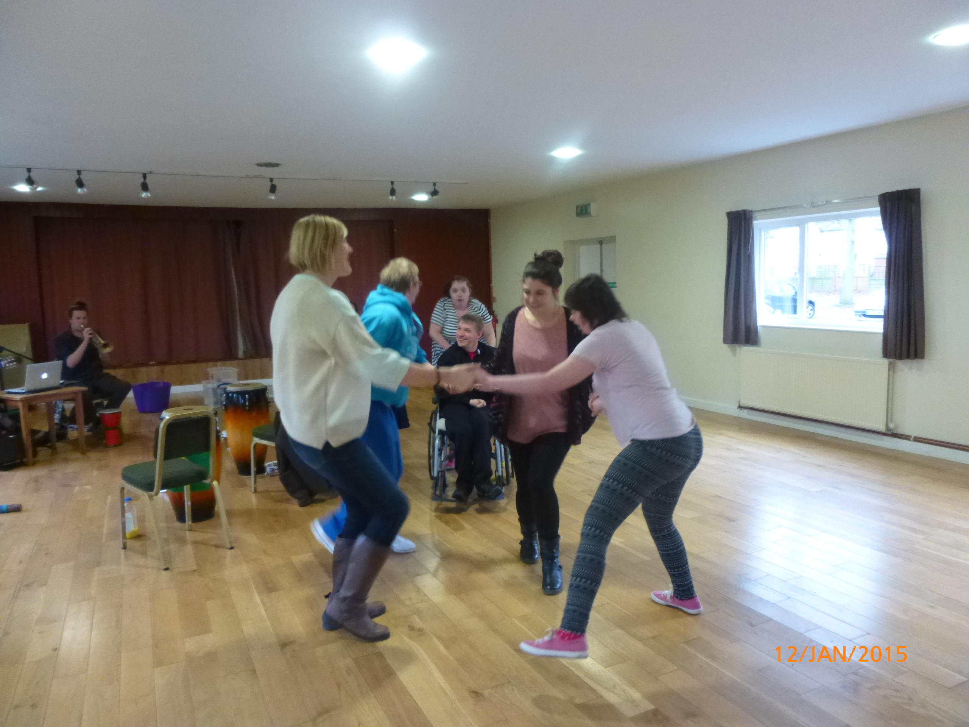
Further details on definition
normal day-to-day activities include everyday things like eating, washing, walking and going shopping
a normal day-to-day activity must affect one of the 'capacities' listed in the Act which include mobility, manual dexterity, speech, hearing, seeing and memory

Slide 35
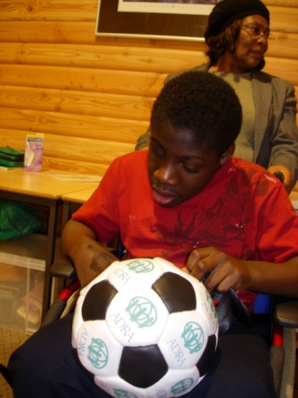
Did you know……?
There are over ………. .......people with a disability in the world (WHO)
……. ……….. people in the UK have a disability

Slide 36
Did you know……?
There are over 650 million people with a disability in the world (WHO
11 million people in the UK have a disability

Slide 37
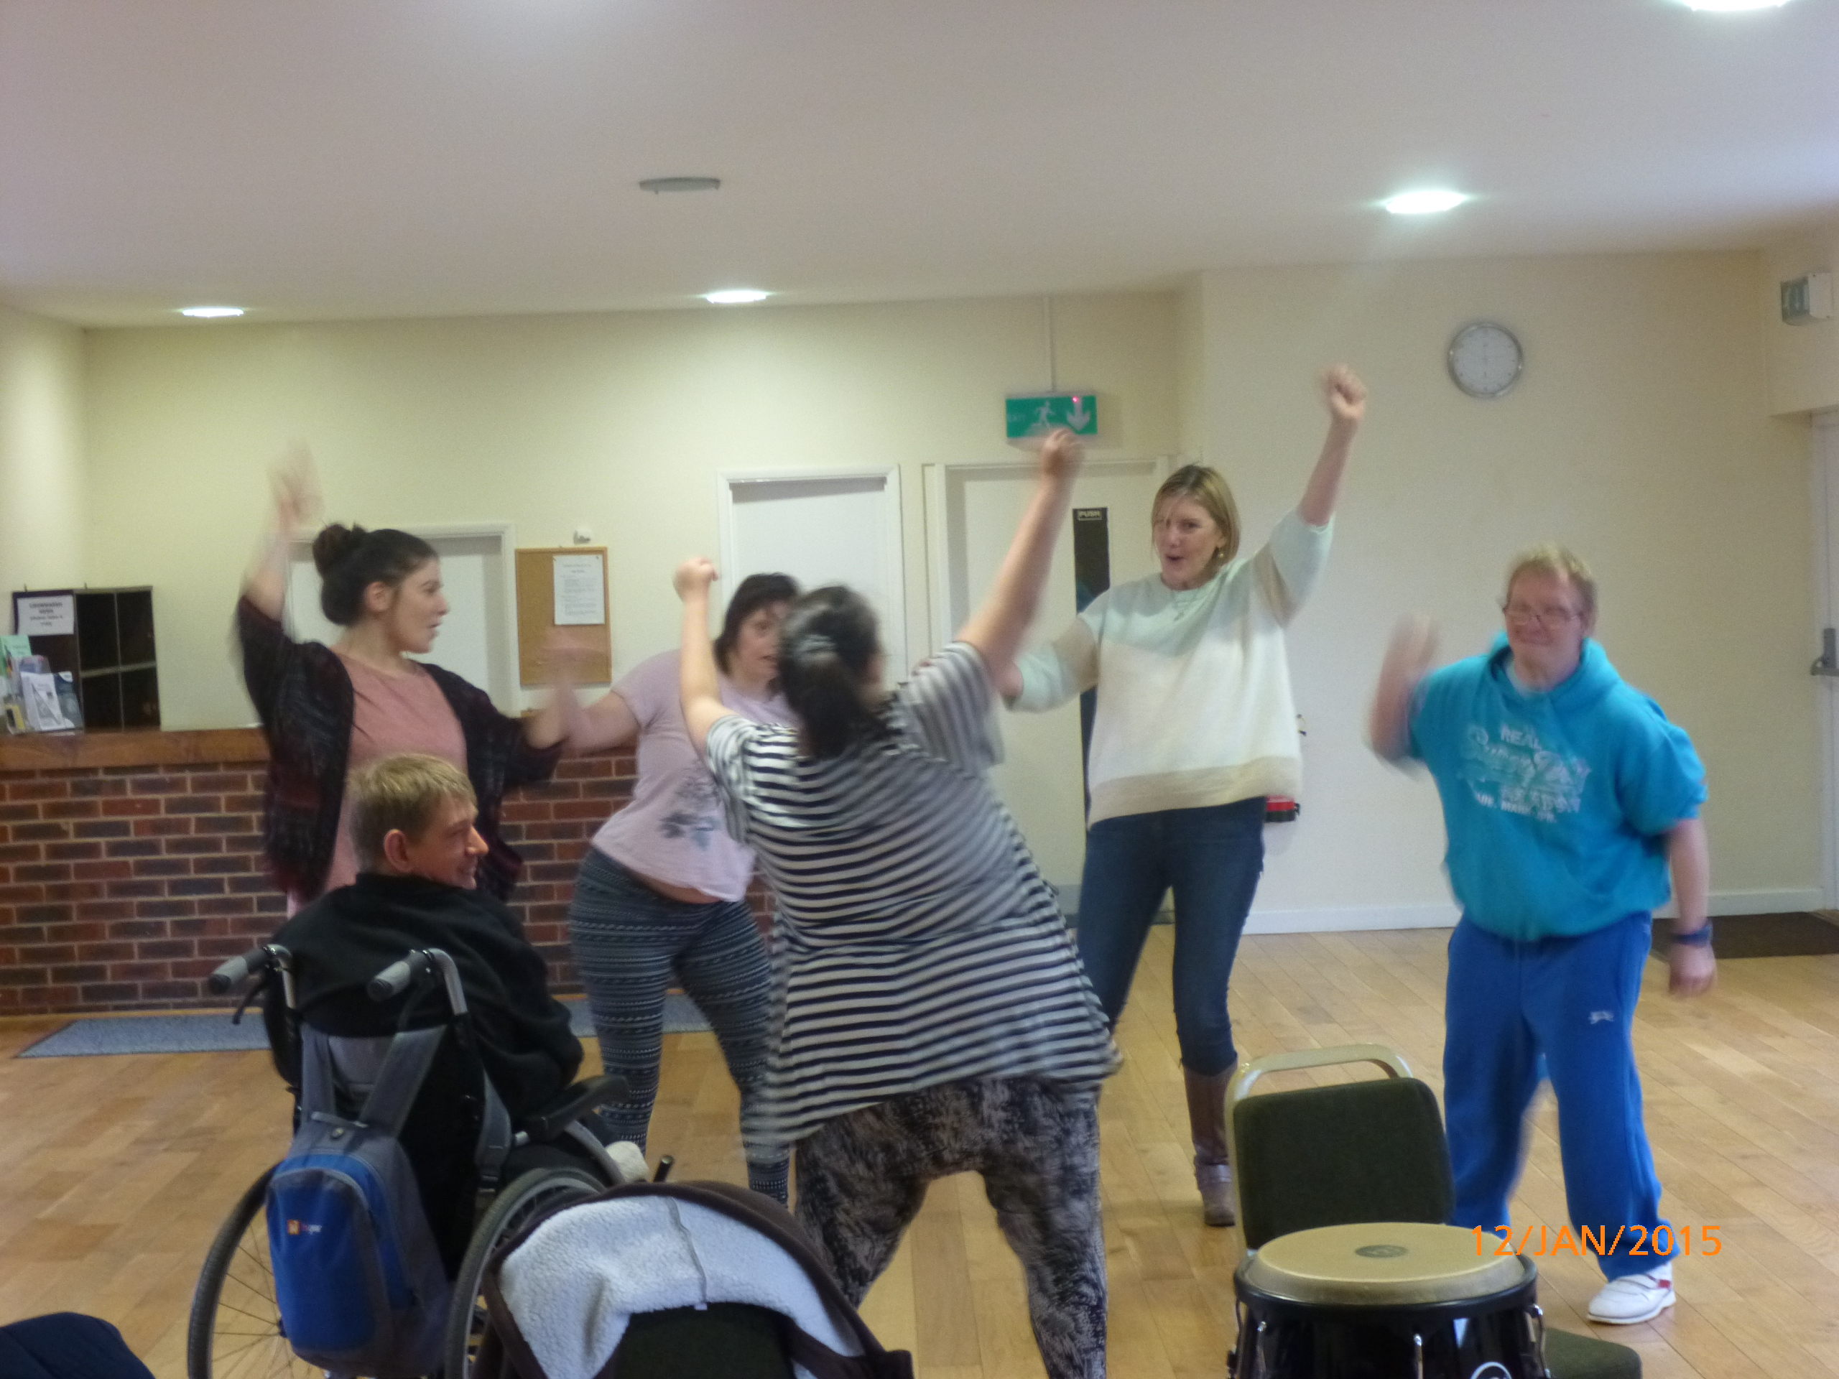
Did you know?
It is possible to become disabled at any time.
People with disability are the:
Poorest in the world
Least educated
Least access to transport
Least evangelised
lowest church involvement

Slide 38
Basic Staff Training: Training the Trainer
Disability Awareness

Slide 39
Least evangelised
lowest church involvement
Why Disability Ministry

Slide 40
The Gospel for all..
Matthews 28: 19 commission:
Go ye therefore, and teach all nations baptizing them in the name of the Father, and the Son and the Holy Ghost”
‘.. to make the gospel accessible to all’.

Slide 41
What are some of the experiences of people living with disability?
What are the experiences in your church community?
CHECK THIS OUT IN YOUR GROUPS

Slide 42
Friendship ministry
Want to feel they belong
Want to develop true friendships
Want to be needed
Want to minister alongside other members

Slide 43
What can your church or other support structure do to help in your caring role?
Social meals and activities.
Keep in touch with a phone call to see how we are doing.
Ring of support
Involve her and let me know she has a ‘place’ in the church and a purpose
Provide resources to help her learn in Sabbath school i.e. picture stories etc.
Provide support if she wants to go no camps or youth weekends
Prayer Support
Visit

Slide 44
Basic Staff Training: Training the Trainer
Disability Awareness

Slide 45
Application
Group 1 - A pathfinder who is Blind
Group 2 - An Adventurer who is Deaf
Group 3 A Pathfinder with Mobility Disabilities
Group 4 An Adventurer with Learning disabilities
Barriers to access
Ideas for inclusion and creating a Sense of Belonging
Using the music honor, choose one requirement and discuss how you would facilitate the learning for the young person with your disability.

Slide 46
Basic Staff Training: Training the Trainer
Disability Awareness

Slide 47
Disabilities & Special Needs – What are they?
Mobility, sensory (blindness), Physical disabilities
Learning difficulty (Hidden)– dyslexia, Dyspraxia, Dyslexia, Hearing impairments, Diabetes, Epilepsy
Learning disabilities –mild, moderate, profound /severe.

Slide 48
Learning disability
A learning disability affects someone's intellectual and social development throughout their life.
1.5 million people in the UK have a learning disability, so it's one of the most common forms of disability in the UK but also one of the least understood.
There are 55,000-75,000 children with a moderate or severe learning disability in England
- Learning disabilities: facts and figures, Department of Health (accessed online 2007)

Slide 49
Learning disability
A learning disability does not stop someone from learning and achieving a lot in life, if they get the right support.

Slide 50
Learning Disabilities
Categorising people with learning disabilities by measuring their IQ alone does not take into account how well they cope day to day or acknowledge their potential.

Slide 51
Learning Disabilities
People with learning disabilities often find it difficult to function independently in society and to communicate with other people.

Slide 52
Learning Disabilities
It is important to see someone with a learning disability as part of society and to consider what she or he needs from society so they are included.

Slide 53
Learning Disabilities
This may be particular kinds of support or positive social attitudes which enable them to reach their potential.

Slide 54
Dyslexia
Possible difficulties.
Reading hesitantly.
Misreading, making understanding difficult.
Difficulty with sequences, e.g. getting dates in order.
Poor organisation or time management.
Difficulty organising thoughts clearly.
Erratic spelling.

Slide 55
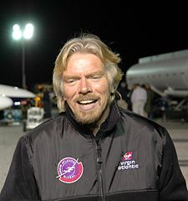
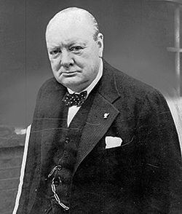
Dyslexia
Possible strengths.
Innovative thinkers.
Excellent trouble shooters.
Intuitive problem solving.
Creative in many different ways.
Lateral thinkers.

Slide 56
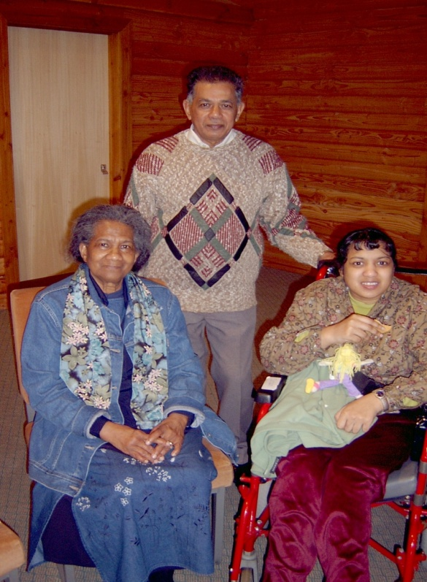
What are the experiences of people living with a disability?
The person with the disability
Family
Friends
Schooling
Church
Other

Slide 57
Experiences of people living with disability
A personal perspective on disability

Slide 58
Experiences of people living with disability
Parent Carers
Isolated
economic, physical, relationship stress
Poor health, 3x more expensive
Guilty – (‘faithless’, ‘sinful’)
Fathers want to fix the problem
Young Carer / Siblings

Slide 59
Barriers to access
What are the barriers to access for:
Mobility difficulties
Learning difficulties
Sensory loss – Deaf, Blind,
Learning disabilities

Slide 60
Main Barriers
Environment –poor access
Attitudinal- cannot do!!
Sensory – over stimulation
Policy – no plan in place
What are your barriers?

Slide 61
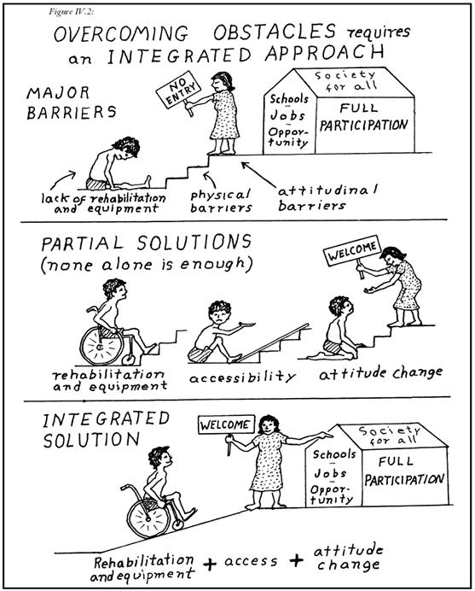

Slide 62
What is the relevance to me as a leader in my church & local community?
To be aware of the diverse nature of the members of the church and local community.
To be aware of the issues facing people affected by disabilities and other challenging situations.
To be aware of legislation and its relevance to your service (Equality Act 2010).
To seek support and educate the members and co – leaders.

Slide 63
Meeting the needs in the community
Before you begin..
Address the issues of attitudes towards those affected by disability and special needs.
Evaluate the access and physical environment of your local service and provision – Is your church disability friendly?
Ask the members of your church and community affected by special needs how the church can help to be more inclusive.

Slide 64
Reaching disabled people in the community
Ask disabled people in the church for ideas.
Ask local disability organisations for what they would find useful.
Be creative about ‘taking church’ to people unable to come to church.

Slide 65
Reaching disabled people in the community
Volunteering in homes for people with learning difficulties
Develop friendships and community provision
Be innovative, creative and patient.
…’that my house may be full’

Slide 66
Projects in the community
Some suggestions for community projects for the ministry to the disabled:
Who may be affected: Adults & Children, Siblings, Carers, teenagers, other relatives
Make new contacts through holding a feast.
An evangelistic outreach service.
A special church based small group ministry for people with learning difficulties.
Camphill church Birmingham
Reading Central

Slide 67
Reading Multisensory Music Ministry

Slide 68
Basic Staff Training: Training the Trainer
Disability Awareness

Slide 69
What can I do to improve access?
S.M.A.R.T ACTION PLAN
Specific, Measurable, Achievable, realistic and timely.
LIST 3 BARRIERS
LIST HOW THEY CAN BE OVERCOME
IDENTIFY 1 BARRIER
WHAT WE CAN DO BY 6 MONTHS TO OVERCOME THIS BARRIERS. BE smart
Review current situation
Identify the need
Take steps to meet
the need
Monitor & evaluate
the steps

Slide 70
The Beatitudes of the Learning Disabled
Blessed are you who take time to listen to difficult speech, for you help us to know that if we persevere we can be understood.
Blessed are you who walk with us in public places, and ignore the stares of strangers, for in your companionship we find havens of relaxation.

Slide 71
Beatitudes of the learning disabled
Blessed are you who never bid us to ‘hurry up’ and more blessed are you who do not snatch our task from our hands to do them for us, for often we need time instead of help.
Blessed are you who ask for our help, for our greatest need is to be needed.

Slide 72
Beatitudes of the learning disabled
Blessed are you when, by all ways, you assure us that the things that make us individuals are not our peculiar muscles, nor our wounded nervous systems, nor our difficulties in learning, but the God- given self which no infirmities can confine.

Slide 73
Beatitudes of the learning disabled
Rejoice and be exceeding glad, and know that you give us reassurances that could never be spoken in words, for you deal with us as Christ dealt with His children.
Author Unknown

Slide 74
Basic Staff Training: Training the Trainer
Disability Awareness

Slide 75
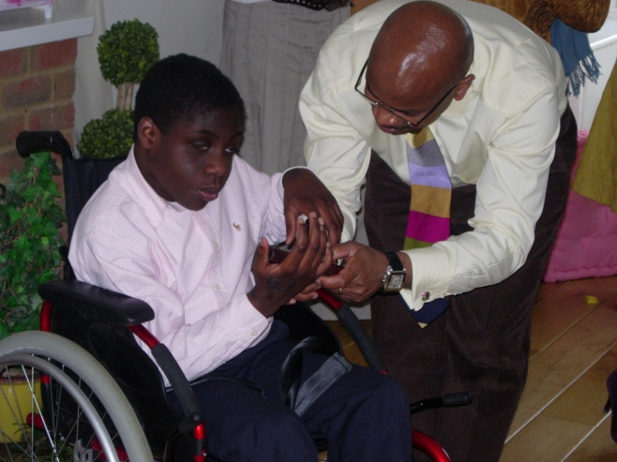
ASNA HISTORY & MISSION
Personal experience of our son Matthew with a disability.
The need for support, information and sharing of experiences.
Our concern for his future with respect to spiritual, social and physical education

Slide 76
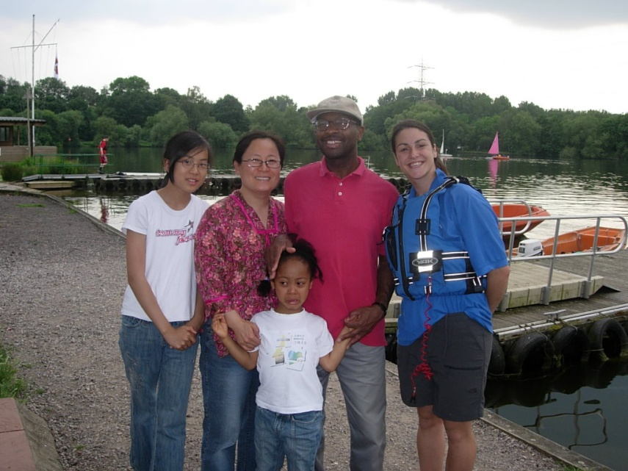
ABOUT ASNA
Launched 2001
Mission: To support people living with special needs and disabilities
Managed and supported by volunteers
2003 became a registered charity
Just over 700 contacts and over 300 members & supporters

Slide 77
ABOUT ASNA - We provide….
Resources – literature, personnel – volunteers, information, advice, advocacy, sign posting
Education and training awareness programmes, workshops, seminars

Slide 78
ASNA - Objectives
Support – Carers weekend, Respite weekends, Family fun days, Young carers project, telephone support, group support, spiritual support for people with special needs and their families

Slide 79
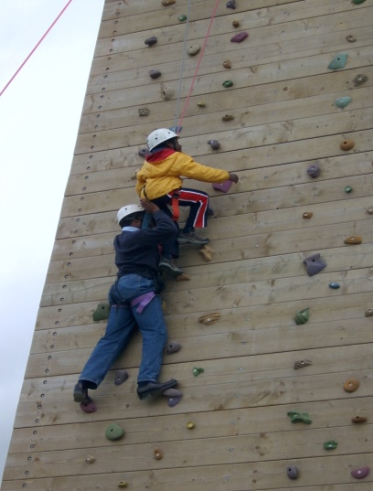
ABOUT ASNA
Financially supported by donations, grants from SEC, Four Acre Trust, ADRA, AREA 5 and some churches, BUC partnership.
Membership subscriptions and donations.

Slide 80
What has been the impact?
People with disabilities and families are not alone.
Members feel more understood
Policy changes in BUC /SEC

Slide 81
Impact? Connecting people: Changing lives
Connections –
Reduced isolation
Empowered
Enabled
Understanding
Improved access to the gospel

Slide 82
ASNA contact details
For General Information or to join ASNA contact :
Sophia Nicholls (ASNA Trustee / Hon. Sec.) on 01491 821103 or 01491 821104 or
Helen Batten (ASNA administrator) on
01491 821103
Email: info@asna.info
Write to Suite W05, Windrush Innovation Centre, Howbery Park, Benson Lane, OX10 8BA
Website: www.asna.info

Slide 83
From Inclusion to ‘A Sense of Belonging’

