Slide 1
GUESS THE ANIMAL GAME

Slide 2
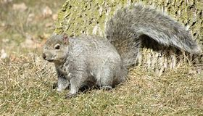
Squirrel

Slide 3
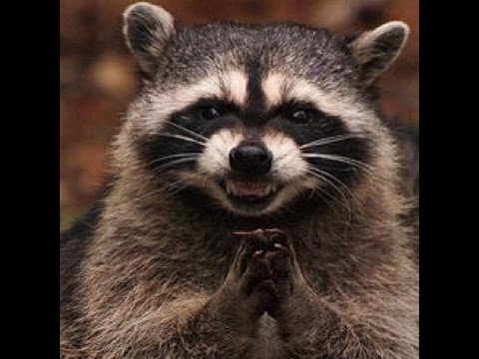
Racoon

Slide 4
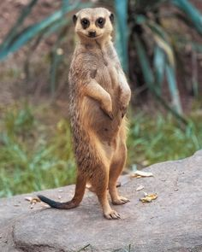
meerkat

Slide 5
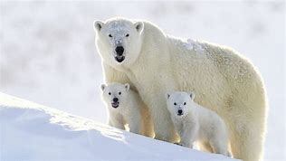
Polar bear

Slide 6
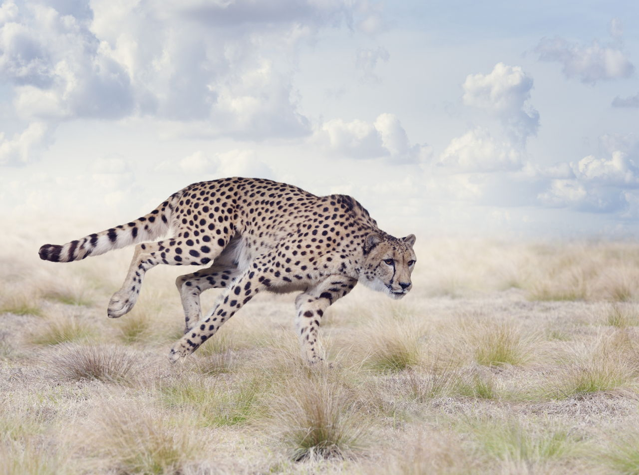
cheetah

Slide 7
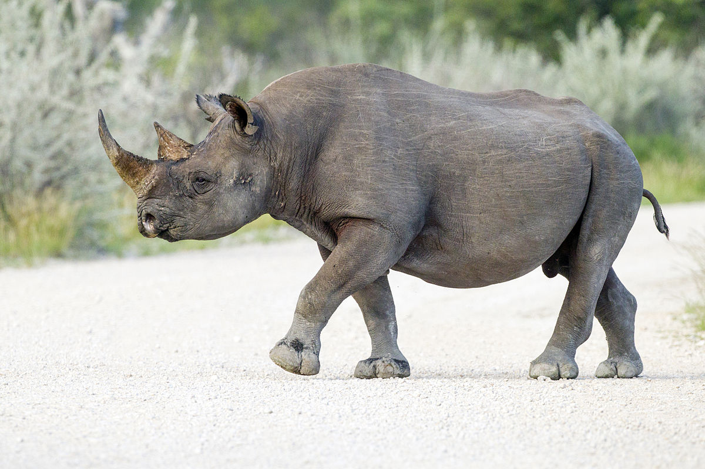
Rhinoceros

Slide 8
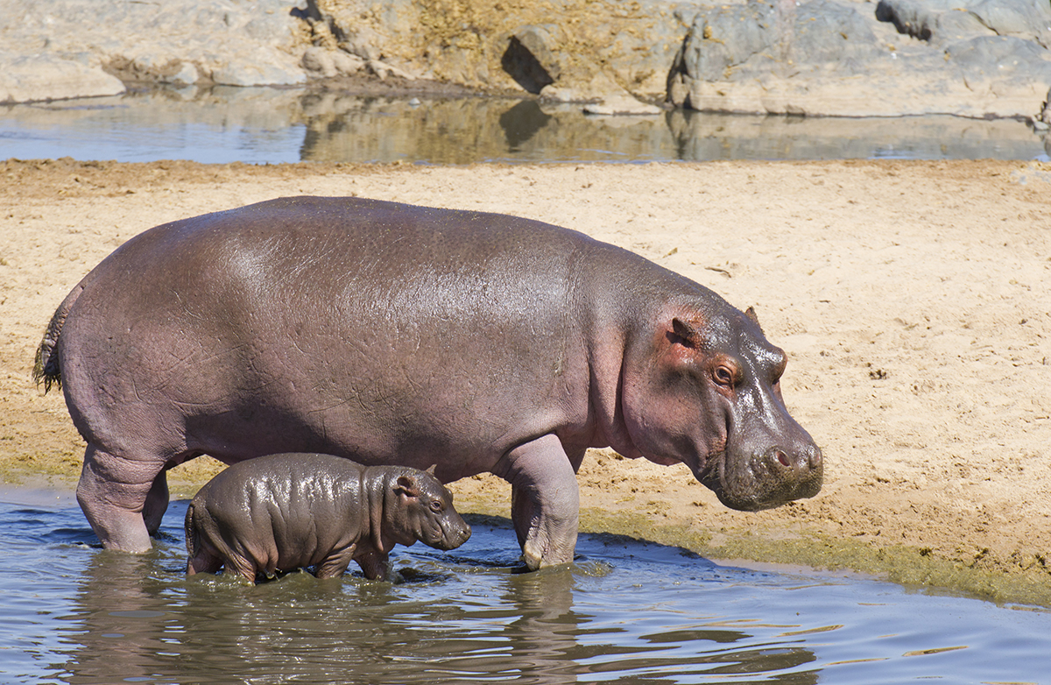
hippopotamus

Slide 9
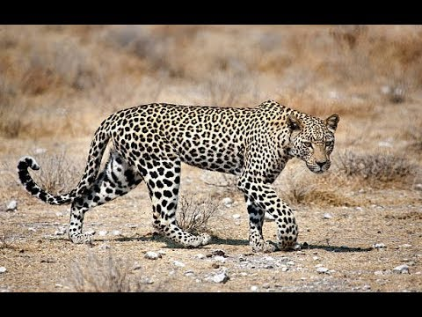
leopard

Slide 10
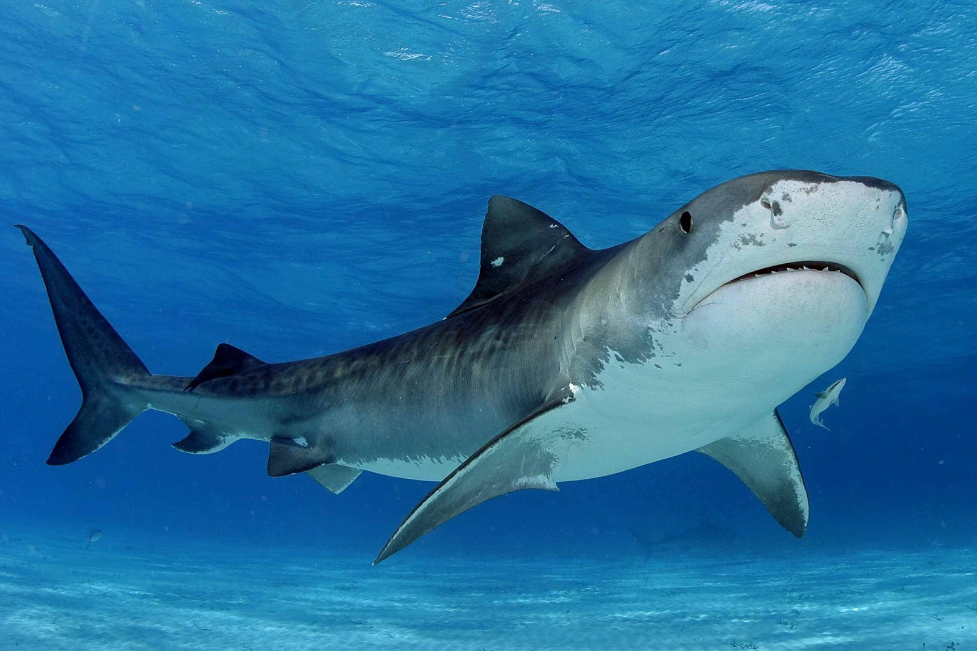
Shark

Slide 11
https://www.bing.com/videos/search?q=jesus+loves+me+by+listener+kids&docid=608044283684913344&mid=96BEC4725A482550090396BEC4725A4825500903&view=detail&FORM=VIRE

