Slide 1
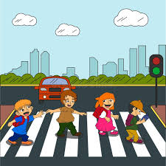
Road Safety

Slide 2
Requirement 1
Identify and explain 10 important road signs

Slide 3
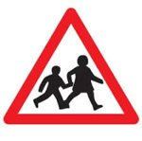

Slide 4
STOP
SPEED LIMIT
SCHOOL CROSSING
NO LEFT TURN
NO WAITING

Slide 6
PEDESTRIAN CROSSING
NO ENTRY
SLIPPERY ROAD
DEAD END
NO CYCLING

Slide 7
Requirement 2
Tell when and where to cross the road safely

Slide 8
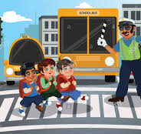
I should cross the road at a......
ZEBRA CROSSING

Slide 9
At a traffic light I should only cross when the man is......
GREEN

Slide 10
Requirement 3
Discuss road safety rules

Slide 11
Discuss road safety rules for:
Walking along the road by yourself
Riding your bicycle
Riding a horse
Walking with a group

Slide 12
a. Walking along the road by yourself
Always walk on the sidewalk
Be safe. Be seen.

Slide 13
a. Riding your bicycle
Wear a helmet
Be aware of slippery surfaces when wet
Keep your bike in good condition

Slide 14
c. Riding a horse
Keep to the left
Keep both hands on the reins, unless you are signalling
Keep both feet in the stirrups

Slide 15
d. Walking with a group
Find a safe place to cross, then stop
Look all around for traffic and listen
Always use sidewalks

Slide 16
Requirement 4
Explain why you should wear a seatbelt when riding a car

Slide 17
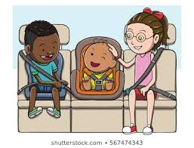
I must wear a seatbelt because it will help protect me in a case of a......
BAD SITUATION

Slide 18
Requirement 5
Road Safety video

Slide 19
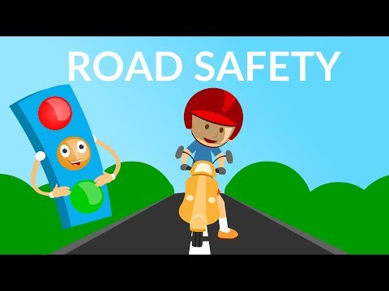
Traffic Rules and Signs

Slide 20
Requirement 6
Play a safety game

Slide 21
Lets Play 'Take the Lead'

